Slide 1
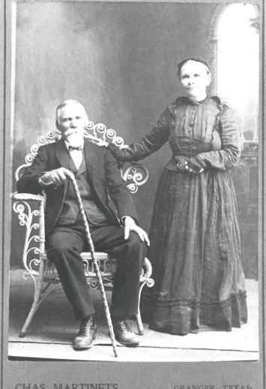
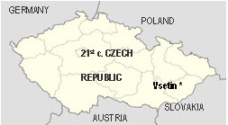
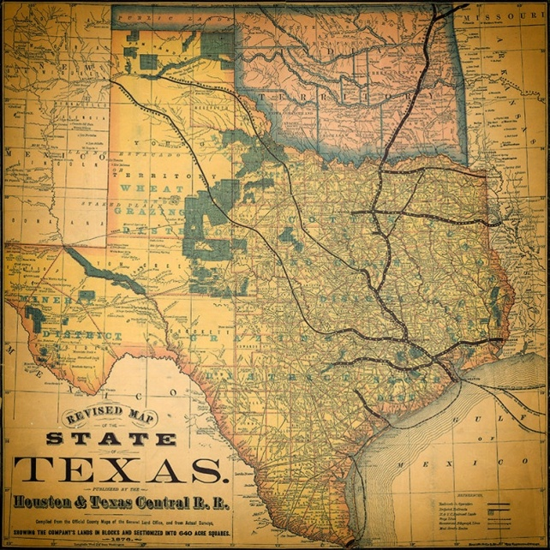
Machu Family Reunion
Beyersville, Texas
September 24, 2023
www.machu-cemetery.org/gallery.php

Slide 2
Machu Family Reunion
OFFICERS
President: Lisa Whisenant
Vice President: Sandra Strmiska
Treasurer: Kendra Werner
Secretary: Christie Johnson
COMMITTEES
Kitchen: Tina Machu, Michelle Hawkins, Sandra Strmiska
Silent Auction: Melody Huber
Facilities: Matt Whisenant
Machu Cemetery Association OFFICERS
President: Sandra Strmiska Vice President: Terry Loessin
Treasurer: Lisa Whisenant
Secretary: Debra Haag Website: machu-cemetery.org Donations: Machu Cemetery Association Perpetual Care Fund c/o Lisa Whisenant 2900 Zachary Lane Taylor, TX 76574

Slide 3
Family Members Invited to:
Machu Cemetery Association Officers Meeting
Saturday October 14, 2023
2:00 p.m.
at Machu Cemetery Pavilion
Afternoon svačina includes kolaches!
In case of inclement weather: Terry Loessin’s home in Circleville
Machu Cemetery Association OFFICERS
President: Sandra Strmiska Vice President: Terry Loessin
Treasurer: Lisa Whisenant
Secretary: Debra Haag Website: machu-cemetery.org Donations: Machu Cemetery Association Perpetual Care Fund c/o Lisa Whisenant 2900 Zachary Lane Taylor, TX 76574

Slide 4
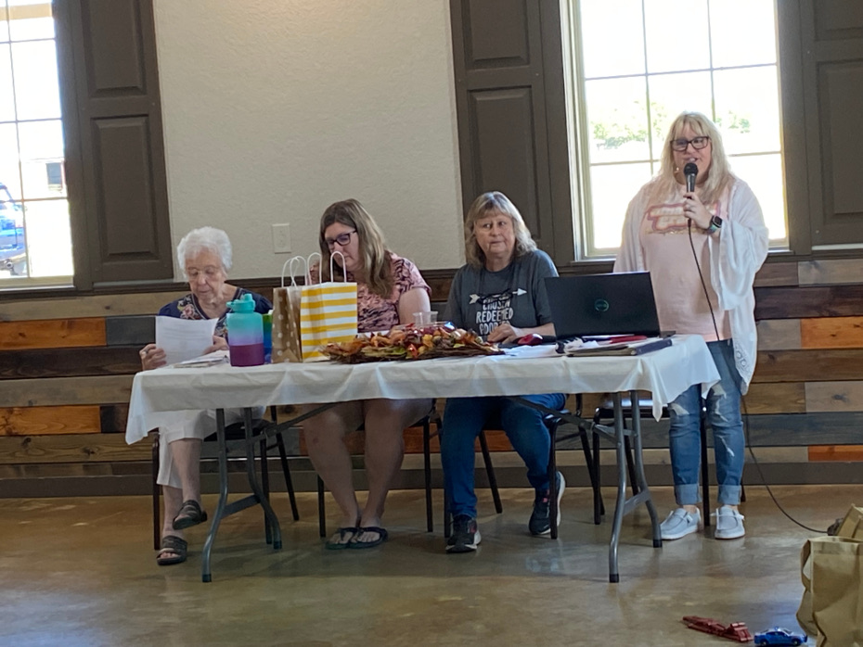
Machu Family Reunion
2022
President Lisa Whisenant facilitates the afternoon Business Meeting along with Treasurer Nancy Machu; Secretary Christie Johnson;
& V. P. Sandra Strmiska

Slide 5
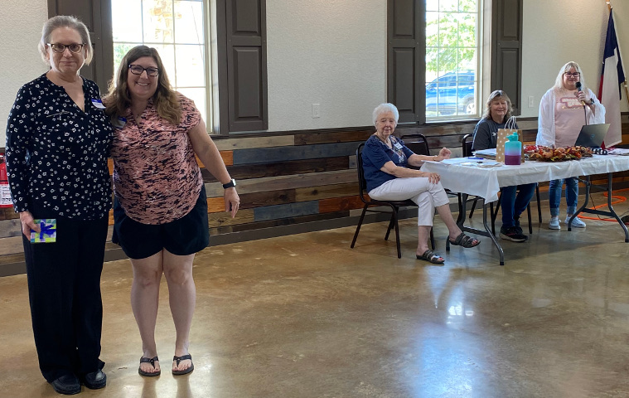
Machu Family Reunion
2022
TINA MACHU gets award for Traveling the Longest Distance!

Slide 6
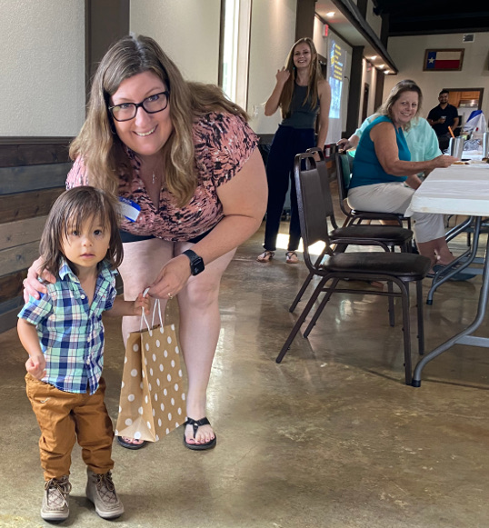
Machu Family Reunion
2022
Secretary Christie Johnson presents ISAAC TORRES
the gift for
YOUNGEST ATTENDEE!

Slide 7
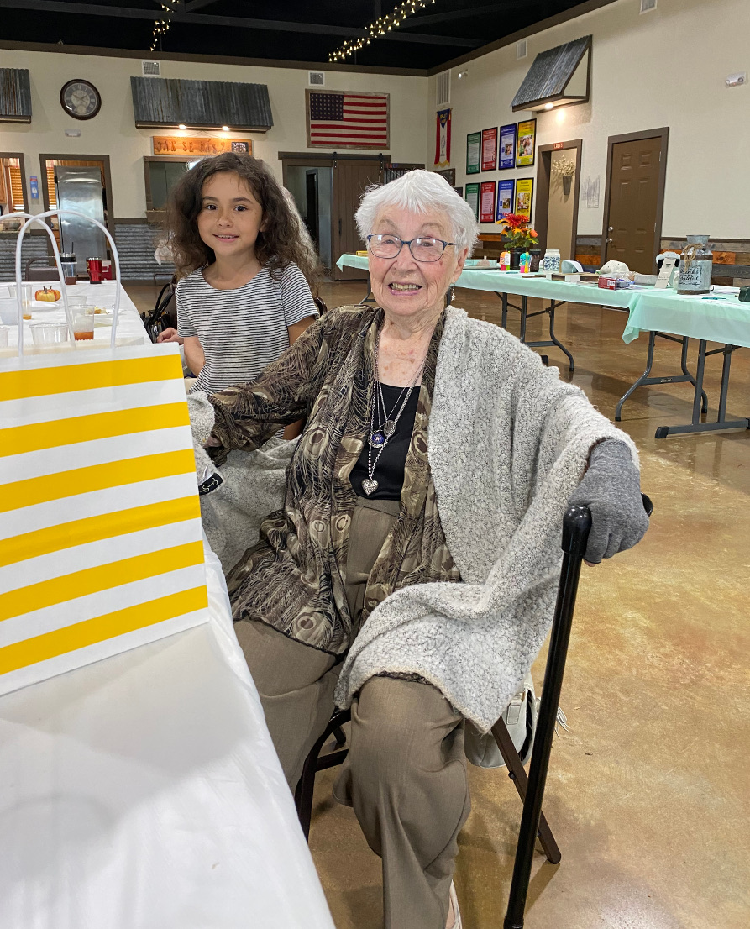
Machu Family Reunion
2022
LILLIE MAE received gift for OLDEST ATTENDEE

Slide 8
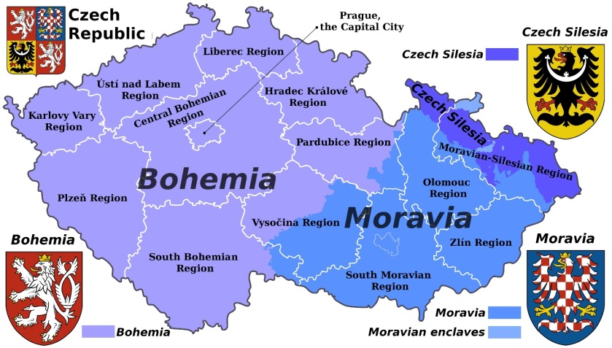
Machu Family
The Machu Family originated in Seninka, a short distance south of Vsetin in the eastern, Moravian region of today’s Czech Republic (or, Czechia).

Slide 9
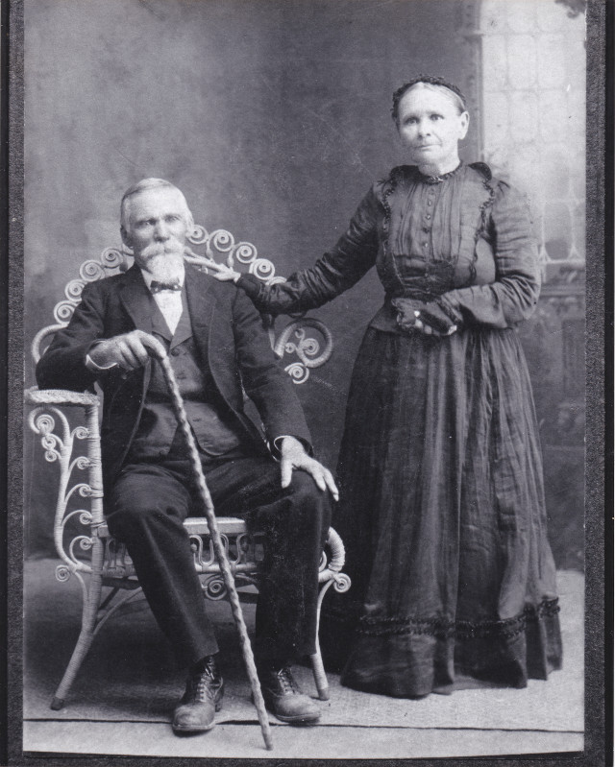
Our Patriarch and Matriarch:
1864: Pavel Machu marries Rozina Trlica.
1870: Pavel applies for permission to emigrate to the USA.
YOUR MACHU ANCESTORS?
April 7, 1870: The family sets sail from the port of Bremen, Germany.
June 2, 1870: The Machu family arrives in Galveston, Texas.
Three children came to U.S. with them:
Anna, who later married Joseph F. Cervenka,
Jan (John) T., who married Veronika Pokorny,
Pavel (Paul) H. who married Rozie Wentrcek.

Slide 10
Jak se máš?
“How are you?"
It's a commonly used greeting phrase for Czechs in the U.S.
Typically the reply is
Dobře!
“Good!”

Slide 11
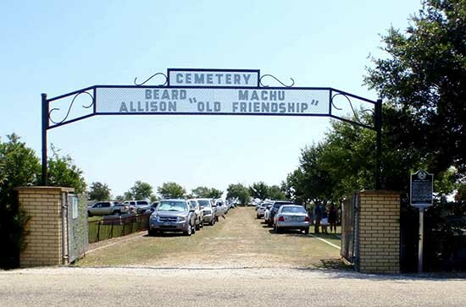
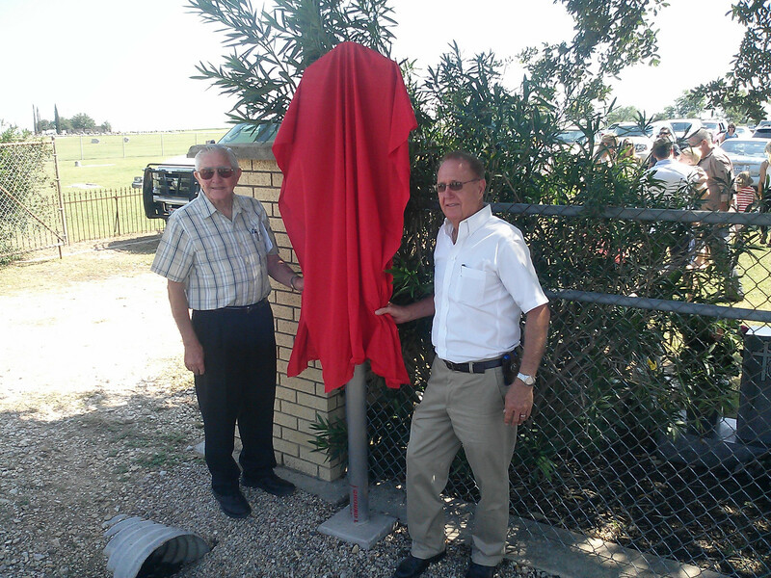
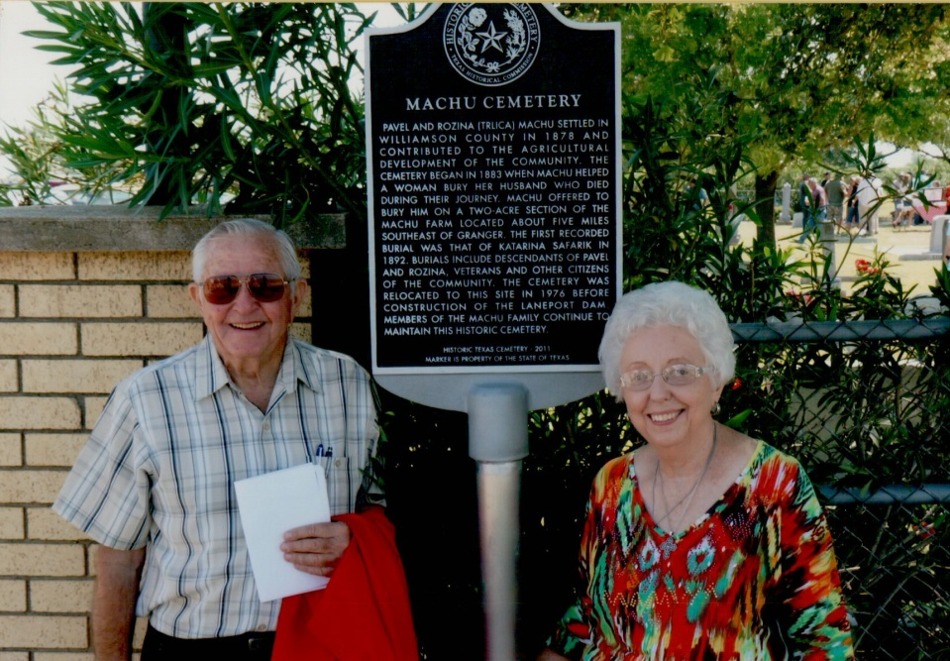
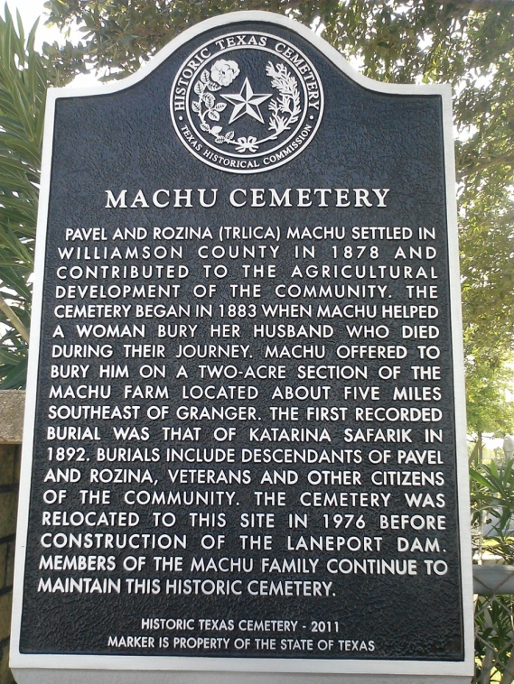
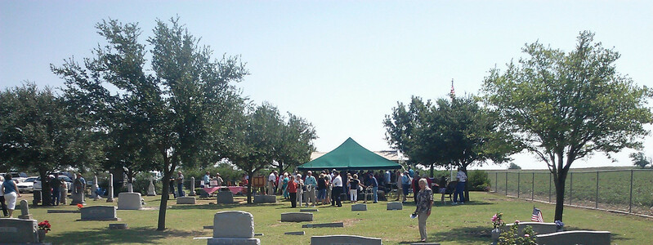
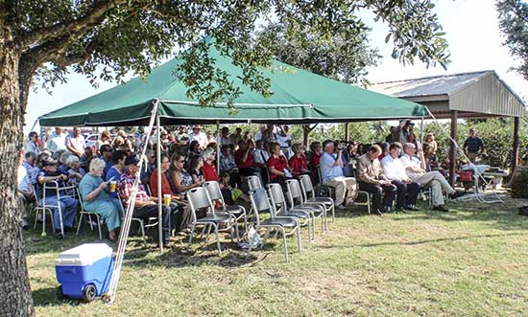
Machu Family
Over 100 attended the Dedication Ceremony for our Cemetery’s Historical Marker on August 17 2013.
Thank you Darwin & Nancy for the research and application work to attain this goal and all who made the special day possible.
Darwin & Albin unveiling Marker

Slide 12
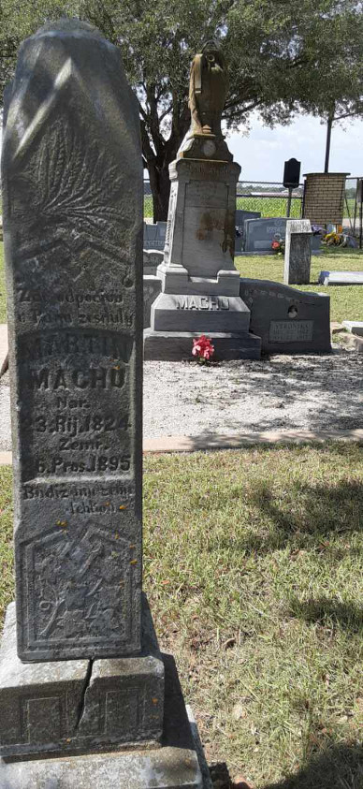
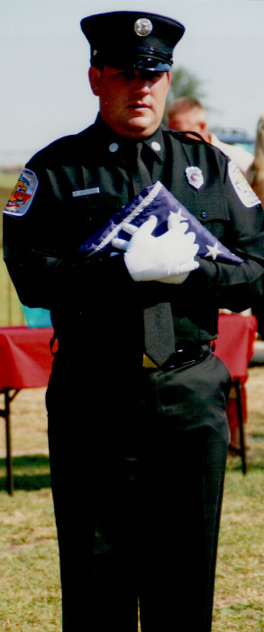
Over 100 attended the Dedication Ceremony for our Cemetery’s Historical Marker on August 17 2013.
Right: The Dedication Ceremony opened with the Presentation of the Colors
by Matt Whisenant

Slide 13
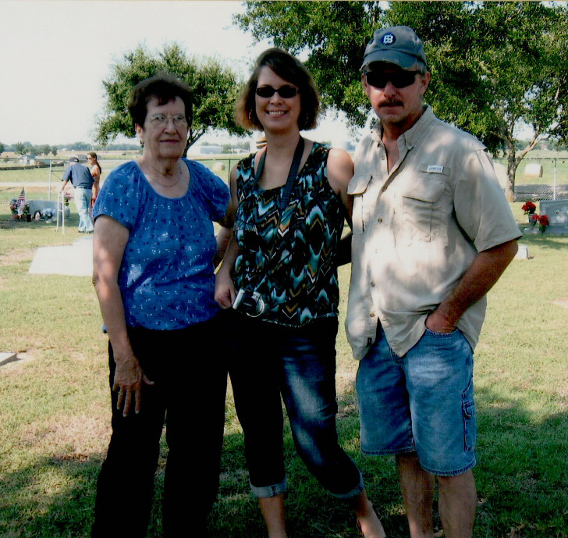
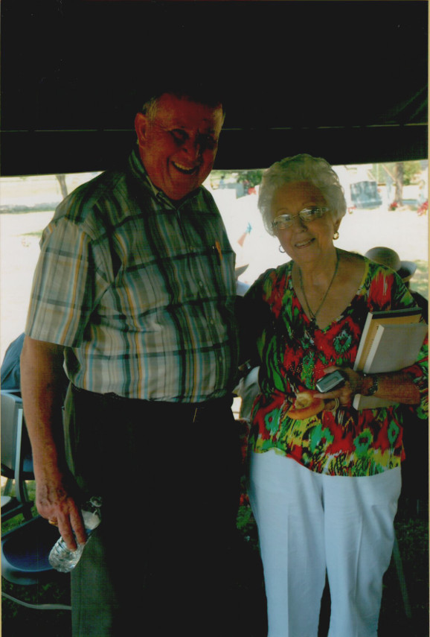
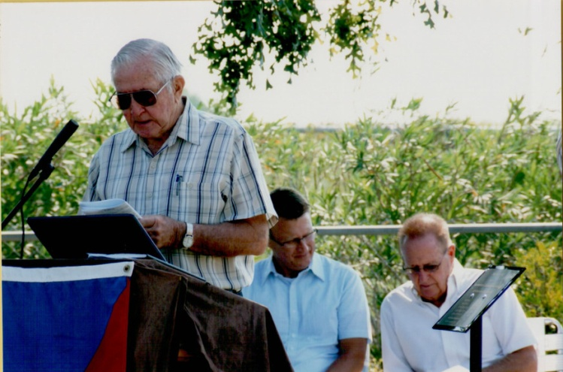
Dedication Ceremony for our Cemetery’s Historical Marker on August 17 2013.
Machu Family
Alice (Machu) Stojanik, Roger & Melody Stojanik Huber;
Henry Holubec with Nancy Machu;
Darwin Machu presenting at ceremony.

Slide 14
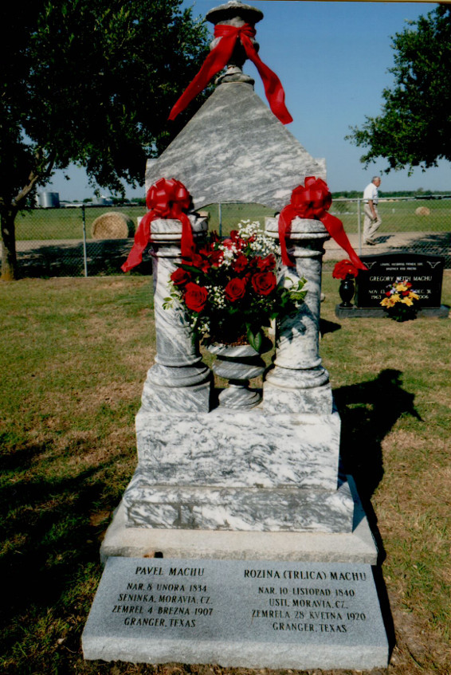
Machu Family Cemetery
Our Family’s Jewel
Pavel & Rozina’s Monument
www.machu-cemetery.org/gallery.php

Slide 15
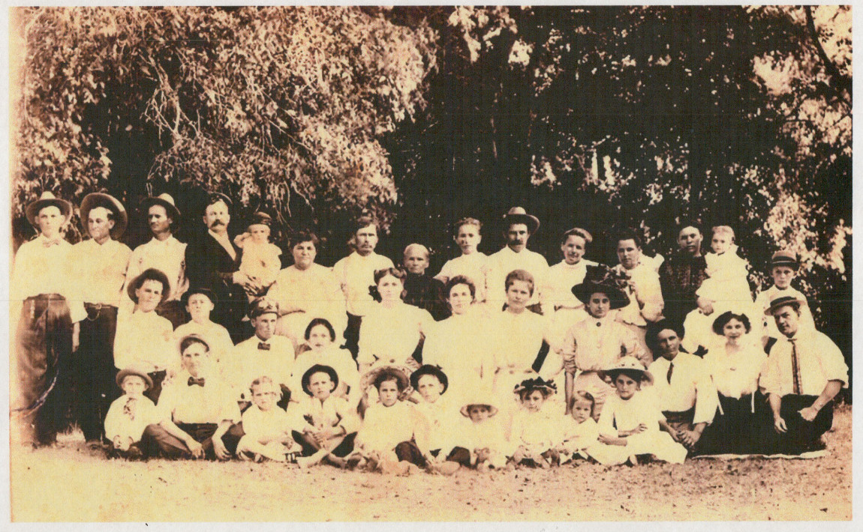
After Pavel died, Rozina (Trlica) Machu sat for this photo with her entire Machu clan
YOUR MACHU ANCESTORS?

Slide 16
Please
Prosim (proseem)
Thank You
Dekuji (dyekuyi)

Slide 17
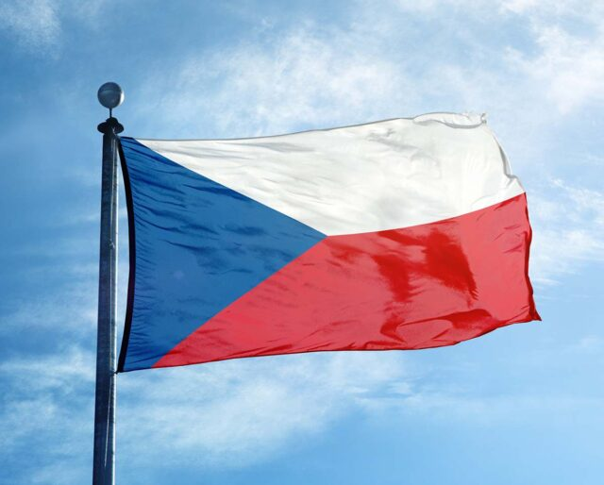
Machu Family
October is Czech Heritage Month, and many Texas Czechs fly the flag of their ancestral home during this month.
Czech Founding Day takes place on October 28 every year, a day of celebration and fun because it observes the founding of the first independent Czechoslovakian state.

Slide 18
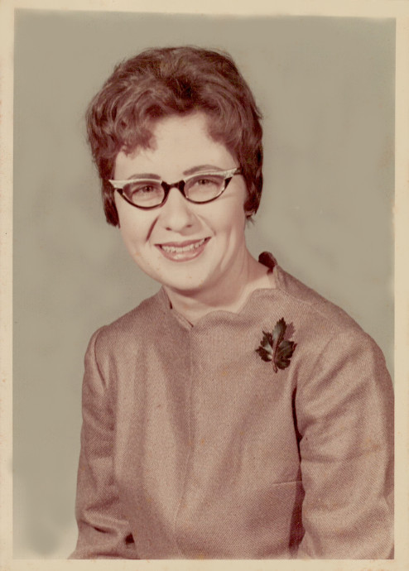
Rubie Mae (Machu) Loessin was the eldest of 9 children born to Albin E. and Vlasta (Kovar) Machu of Granger on March 24, 1941.
Rubie’s life of active service within her family and community included leadership roles in Granger’s Czech Brethren Church and SPJST Fraternal Lodge 20 as well as her devotion to the Machu Family’s annual reunion and cemetery care.
Rubie and her husband of 62 years, Leslie, resided in Circleville where Rubie ran a daycare out of their home for 35 years. She was a well-loved caregiver – of her siblings in their youth, of her grandparents and parents, the numerous children she raised in her home, including her own two sons, Terry and Kelly.
Rubie departed this life on August 9, 2023.

Slide 19
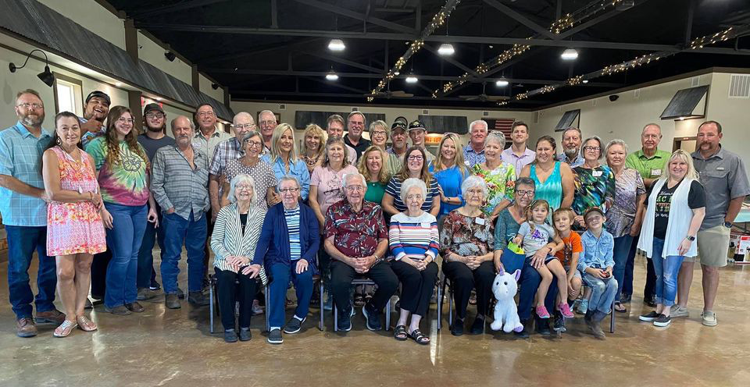
Machu Family Reunion
Beyersville, Texas
2021

Slide 20
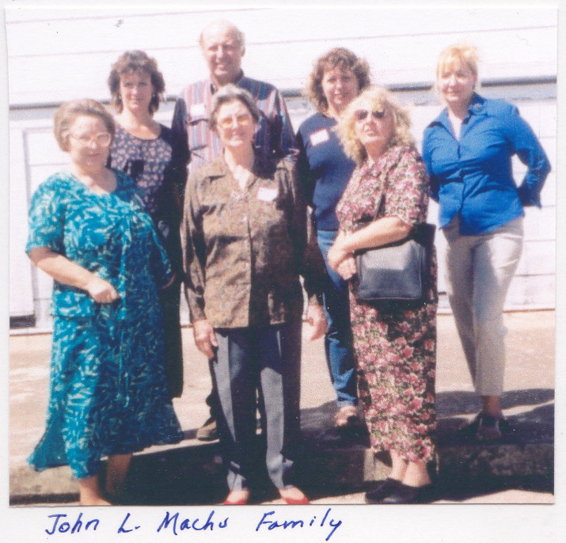
Machu Family Reunion
2003
John L. Machu descendants
20 years ago

Slide 21
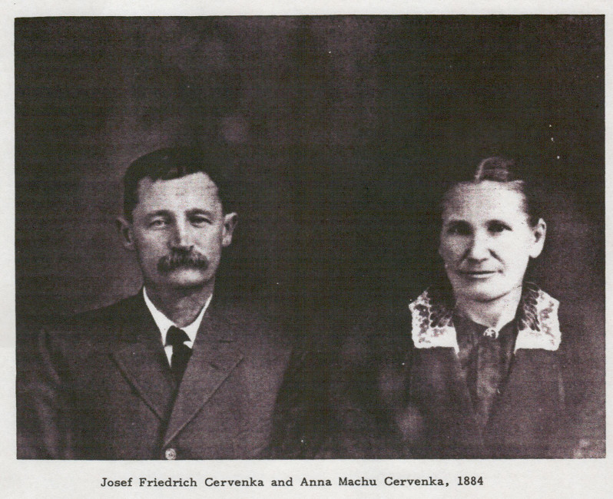
Pavel & Rozina Machu
had 9 children:
Anna, Paul, Rosie, Joe R., Frances, Charles, Mary, Frank Louis, and John T.
YOUR MACHU ANCESTORS?
Josef and Anna Machu Cervenka in 1884

Slide 22
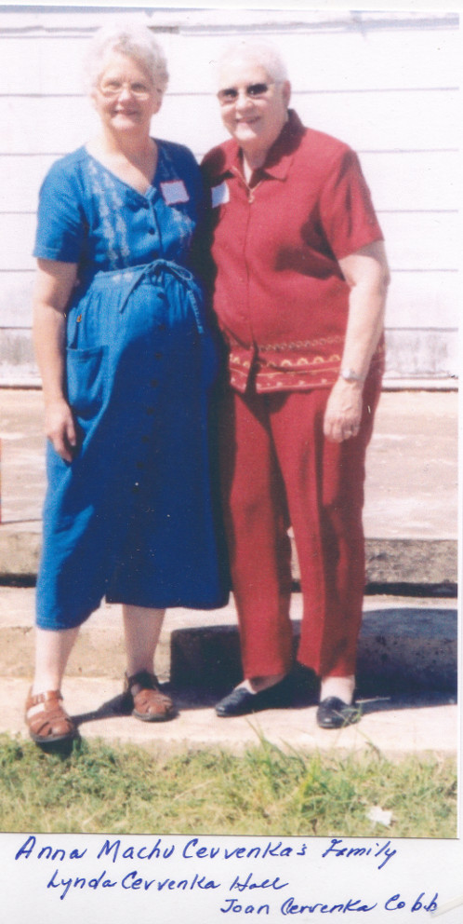
Machu Family Reunion
2003 Anna Machu Cervenka descendants
20 years ago
Lynda Cervenka Hall
Joan Cervenka Cobb

Slide 23
1 – Jedna
2 – dva
3 – tři
4 – čtyři
5 – pět
6 – šest
7 – sedm
8 – osm
9 – devět
10 – deset

Slide 24
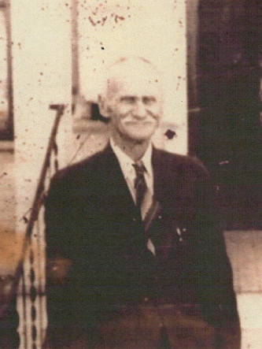
Pavel & Rozina Machu
had 9 children:
Anna, Paul, Rosie, Joe R., Frances, Charles, Mary, Frank Louis, and John T.
YOUR MACHU ANCESTORS?

Slide 25
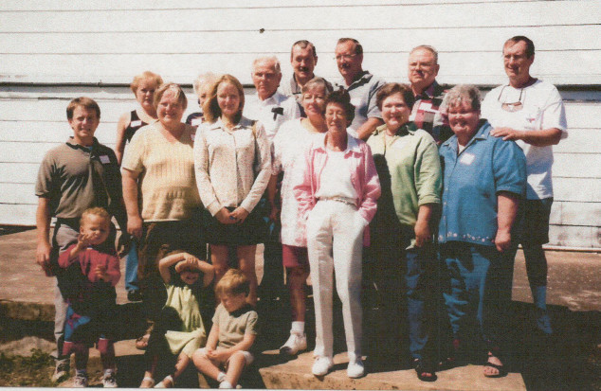
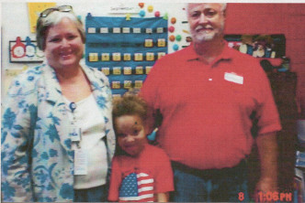
YOUR MACHU ANCESTORS?
Paul H. Machu (left) descendants, including Cindy and Monk Montgomery (right)

Slide 26
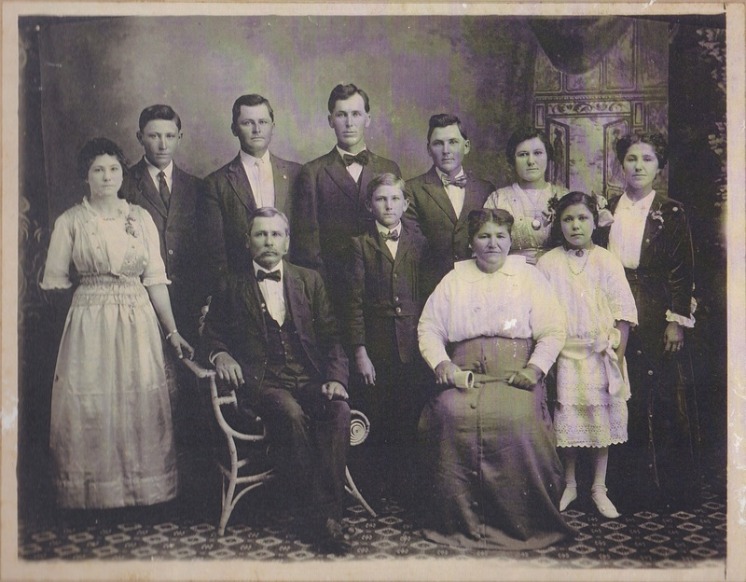
Our Patriarch and Matriarch:
Pavel & Rozina Machu
had 9 children: Anna, Paul, Rosie, Joe R., Frances, Charles, Mary, Frank Louis, and John T.
YOUR MACHU ANCESTORS?
Pictured : John T. Machu
and his wife Veronika (Pokorny) and their 9 children.

Slide 27
Pictured : John T. Machu and his wife Veronika (Pokorny) and their 9 children: (from left) Vera, Anton P., John L., Joe M., Raymond, Frank R., Rosie, Bertha, and young Albina.
YOUR MACHU ANCESTORS?
John T. Machu was 3 y.o. when he immigrated from Usti, Moravia to Texas in 1872 with his parents Pavel and Rozina (Trlica) Machu. Veronika was 11 when she immigrated from Polanka, Moravia to Texas in 1881 with her parents Josef and Rozina (Belicek) Pokorny.

Slide 28
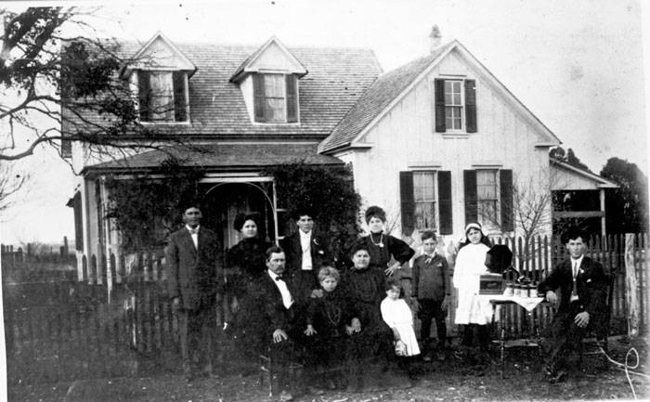
Pictured : John T. Machu
and his wife Veronika (Pokorny) and their 9 children.
YOUR MACHU ANCESTORS?
Like many families at photo time,
a son could not be pulled away from his tech gadget –
in this case, Joe M. keeps his Victrola at close at hand!

Slide 29
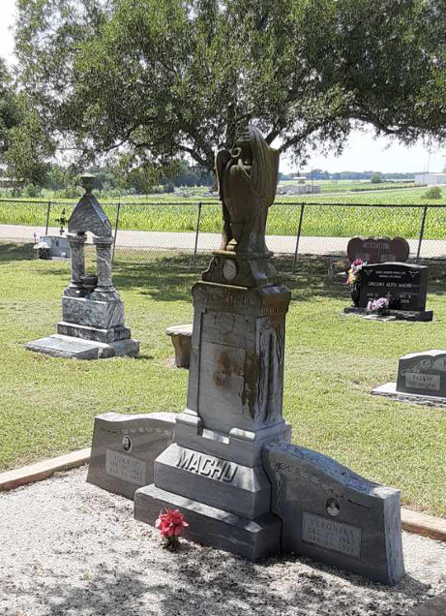
Pictured : John T. Machu
and his wife Veronika (Pokorny) have one of the more impressive monuments at the
Machu Family Cemetery.
The couple were active pillars
in the life of their Czech community in Williamson County, while raising their nine
children.
John T. was a leader at the local and state level in the Czech Brethren Church and S.P.J.S.T.
YOUR MACHU ANCESTORS?

Slide 30
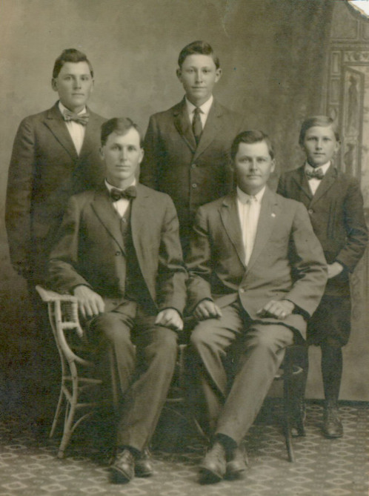
YOUR MACHU ANCESTORS?
The sons of John T. Machu:
Joe, John,
Frank, Anton, Raymond

Slide 31
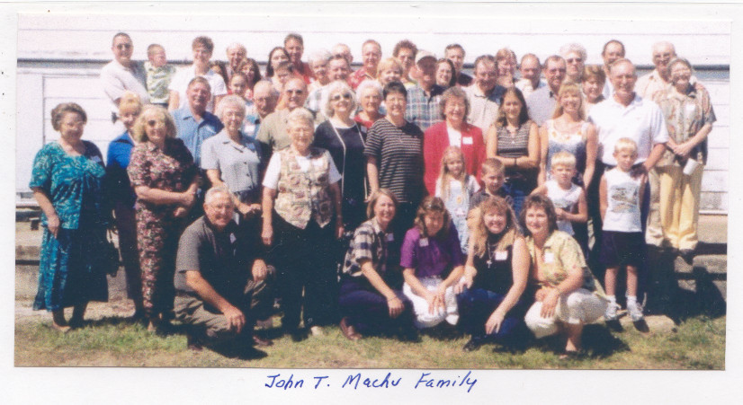
Machu Family Reunion
2003 John T. Machu descendants
20 years ago

Slide 32
Bez práce nejsou koláče.
“Without work, there are no koláčes!”
A meaningful proverb that,
not surprisingly,
reflects the Czech culture’s work ethic!

Slide 33
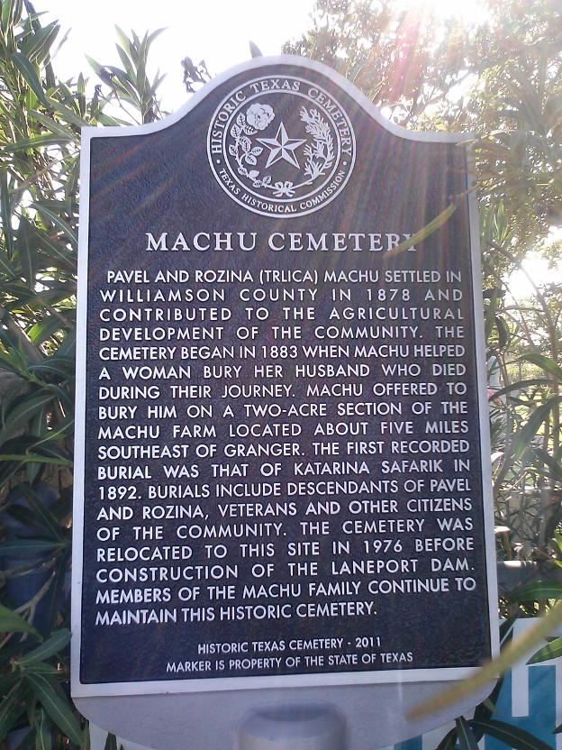
Please consider making a Memorial Donation in the name of a loved one toward the Perpetual Care and Restoration projects of our Cemetery.
Send donations to:
Machu Cemetery Association c/o Lisa Whisenant 2900 Zachary Lane Taylor, TX 76574
machu-cemetery.org

Slide 34
Over 40 Archival Photos
WOULD YOU LIKE A COPY OF THIS PRESENTATION? HERE IS A GREAT RESOURCE FOR INTRODUCING YOUR YOUNGSTERS (and those new In-Laws) TO OUR FAMILY HISTORY & ANCESTORS
View Anytime or Download it at:
Machu-cemetery.org/Gallery.php

Slide 35
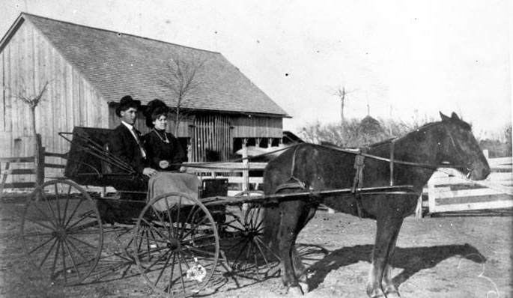
Can you identify this smartly dressed church-going couple?
YOUR MACHU ANCESTORS?
Joe and Albina Machu; circa 1905

Slide 36
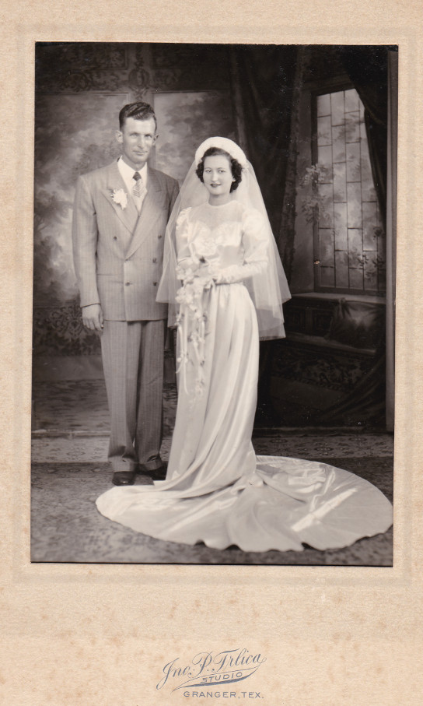
YOUR MACHU ANCESTORS?
Can you identify this couple?
It is

Slide 37
Dobrá rada nad zlato.
“Good advice is better than gold.”
Hněv je špatný rádce.
“Anger is a bad advisor.”

Slide 38
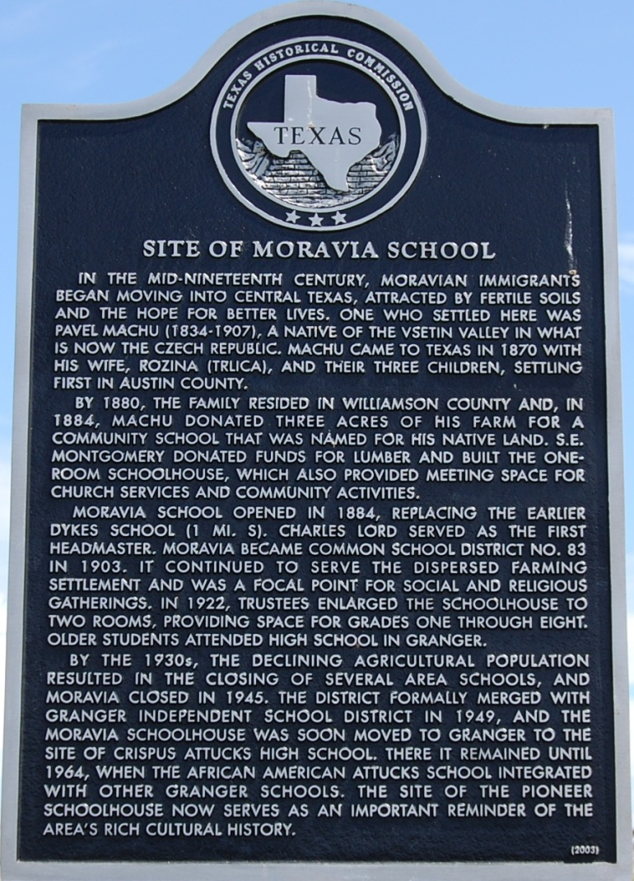
Machu Family
Imagine - an immigrant with no education and limited English, Pavel managed to provide a school in central Texas for the children of his fellow countrymen from Moravia. Pavel Machu committed himself to getting the Moravia School built, aided by other farmers living nearby. He donated a portion of his farm for the school and traveled to surrounding towns on horseback, soliciting funds for construction costs.

Slide 39
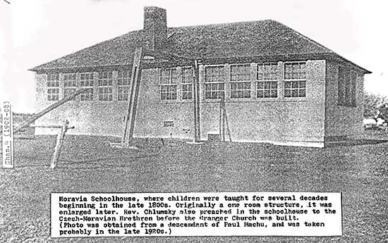
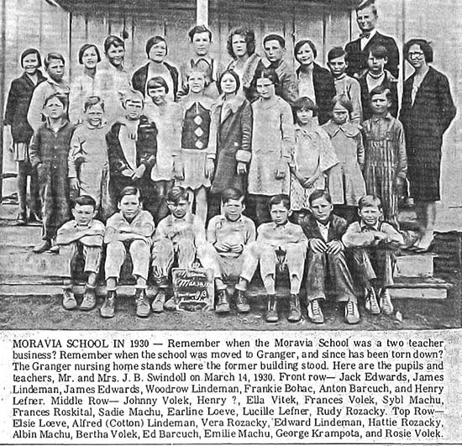
Pavel Machu committed himself to getting the Moravia School built.
Machu Family

Slide 40
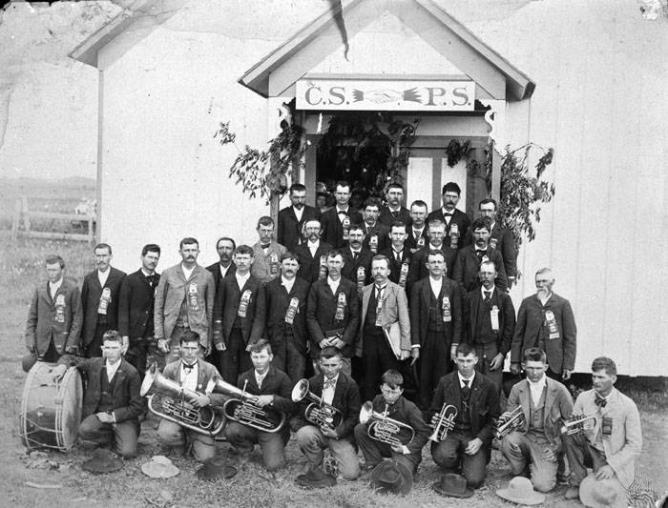
In addition to his efforts to found the Moravian School for his Czech community, Pavel was also instrumental in forming a fraternal insurance agency to aid his Czech neighbors in need.
Machu Family
That early agency was the Cesko-Slovanska Podporujici Spolecnost (CSPS) Lodge in Granger. The CSPS was absorbed by SPJST organization after 1897..

Slide 41
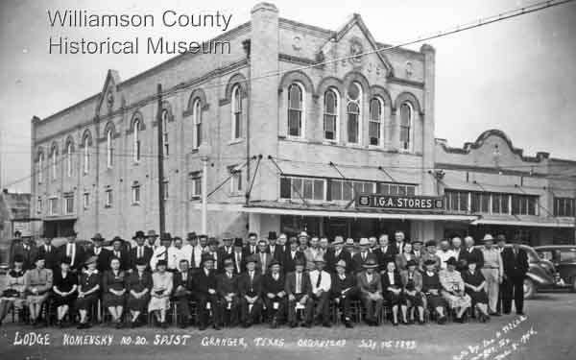
Machu Family
Pavel and Rozina were among the founding members of Granger's Lodge 20 of the Czech fraternal insurance group SPJST. Members posed here in front of the lodge hall, a city property the lodge purchased from Rozina
in 1907.
Photo taken by Pavel and Rozina's nephew John P. Trlica, the well-known Granger photographer.

Slide 42
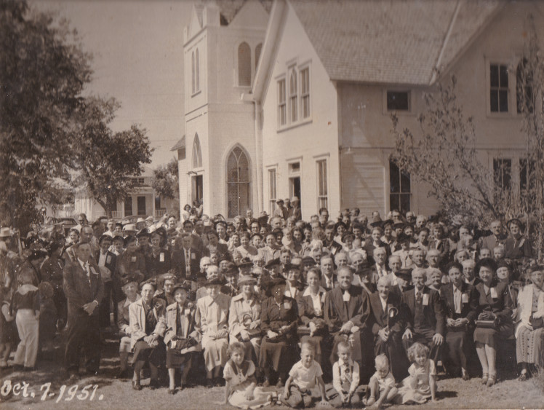
Pavel and Rozina were instrumental in establishing the first Czech Protestant church
in central Texas, the Czech Moravian Brethren Church, a denomination whose origins date
back to the 15th century Hussites of Czech Bohemia. The first church services in the area were held at the Moravia School.
Machu Family
Pavel and Rozina’s children and grandchildren’s rites of passage centered around the Brethren Church.
In this 1951 pic of a State Convention are 25 Machu family members!

Slide 43
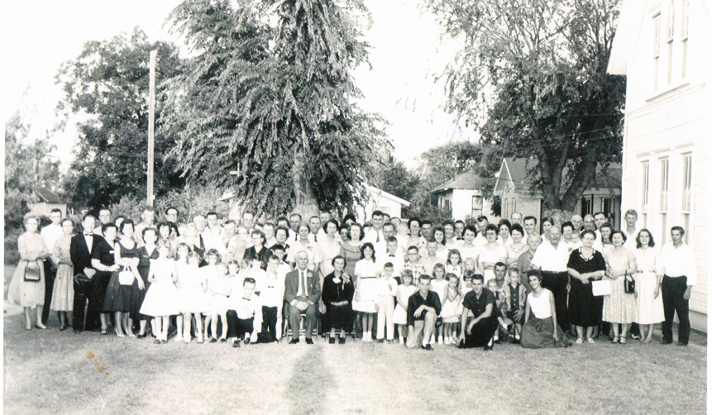
All of Pavel and Rozina’s children and grandchildren’s rites of passage centered around the Brethren Church
Below, their grandson Joe M. Machu and wife Tracy (Zetak) celebrate their 60th anniversary with the Machu clan.
Machu Family

Slide 44
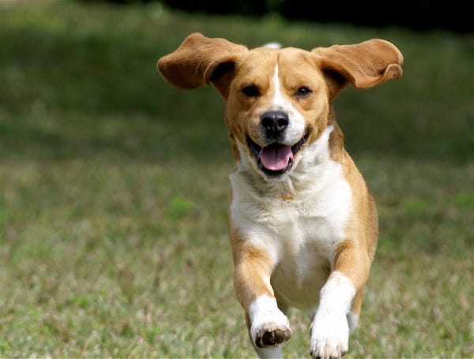
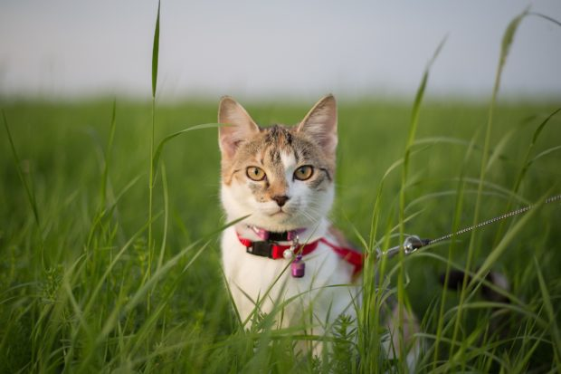
Pes
Kočka

Slide 45
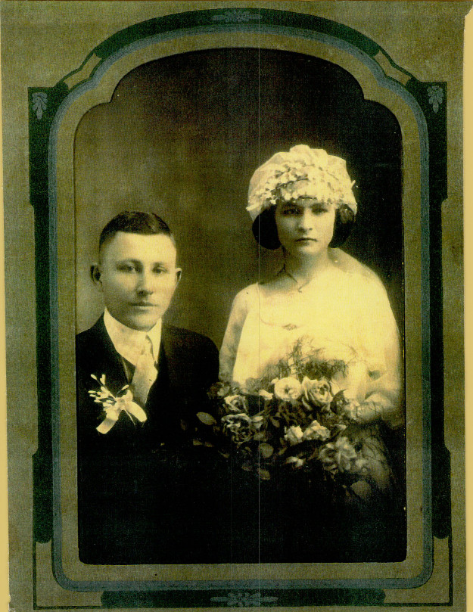
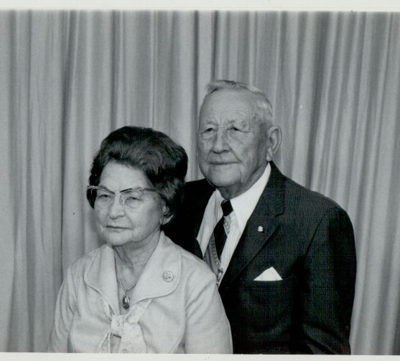
YOUR MACHU ANCESTORS?
Anton & Millie Machu

Slide 46
YOUR MACHU ANCESTORS?

Slide 47
WWII Veteran Clarence E Machu
YOUR MACHU ANCESTORS?
WWII Veteran Daniel Thomas Blaha Sergeant, U.S. Marines
VETERANS
WWI Veteran Frank Machu
Brandon Johnson U.S. Army 1991-94; TX National Guard 2014-present
WWII Veteran Henry E Ripple, Sr.
U.S. Army Veteran Darwin L Machu
Vietnam War Veteran Albin F Machu

Slide 48
VETERANS
YOUR MACHU ANCESTORS?
World War I Veteran Frank Machu
Left: Frank and John L. Machu

Slide 49
Darwin L. Machu was born in Granger, Texas on July 8, 1931 to Anton & Millie [Kveton] Machu. Darwin would marry wife Nancy [Bryan] and they raised son Greg and daughter Rhonda. They are active today in their retirement promoting and preserving Czech history and culture.
YOUR MACHU ANCESTORS?
VETERANS
Darwin was inducted into the U.S. Army in 1952 and did his basic training at Camp Roberts in California. Because of his fluency in Czech he was assigned to the 513th Military Intelligence Service in Germany.
He served as Companion to people who had escaped from behind the Iron Curtain and had asked for asylum. Corporal Darwin Machu was discharged on September 19, 1953.

Slide 50
Descending from the John T. Machu line is:
Albin F. Machu, son of Mr. & Mrs. Albin E. Machu of Granger, Texas.
During the Vietnam Confict Albin served in the United States Marine Corps’ 3rd Battalion; 23rd Marines; 4th Marine Division.
1964-1970: State-Side Marine Corps Reserve; Camp Pendleton; San Diego, California.
YOUR MACHU ANCESTORS?
VETERANS
Combat Training – Camp Swift, Bastrop TX; Duties included Infantry Division, Truck Driver, Honor Guard.
1966, Albin’s Marine Unit’s First Tour of Duty to Vietnam was, within hours of departure, called off by President Lyndon B. Johnson.
Serving in the Honor Guard (1966-70) Albin was called upon to attend many funerals for fallen Marines from the central Texas area.

Slide 51
Descending from the Martin Machu line is:
Pfc Clarence E. Machu, son of Mr. and Mrs. Emil Machu of Manor, Texas.
During World War II Clarence volunteered for service Feb. 10, 1943, at Austin. He was assigned to the 2nd Marines, and was trained at San Diego and Camp Elliott, California.
He served overseas from July 1, 1943, until May 1, 1945, in New Caledonia, New Zealand, Hawaii, and fought in the battles of Tarawa, Saipan, Guam, and Iwo Jima.
Awards include: two Presidential Unit Citations, one Navy Unit Citation, and the Asiatic Pacific Campaign Ribbon with 4 Bronze Stars.
YOUR MACHU ANCESTORS?
VETERANS

Slide 52
Anton Ludwig Pokorny was born in Taylor, Texas August 25, 1920 and passed away February 1, 2019.
YOUR MACHU ANCESTORS?
VETERANS
Anton was a WWII veteran and served as an Army Maintenance Motor Sergeant in the 77th Field Artillery. After the war, he and wife Fay moved to California with sons Anton and Oscar where he worked for Lockheed Martin for 29 years.
Awards include: The bronze star and six battle stars.

Slide 53
WWII Veteran Clarence E Machu
YOUR MACHU ANCESTORS?
WWII Veteran Daniel Thomas Blaha Sergeant, U.S. Marines
VETERANS
WWI Veteran Frank Machu
Brandon Johnson U.S. Army 1991-94; TX National Guard 2014-present
WWII Veteran Henry E Ripple, Sr.
Vietnam War Veteran Albin F Machu

Slide 54
Hattie Machu confirmation photo.
YOUR MACHU ANCESTORS?
Hattie Machu Holubec Kollaja with her grand-nephews Terry and Kelly Loessin. She baked 3 cakes for Terry’s confirmation!

Slide 55
YOUR MACHU ANCESTORS?
Albin E. and Vlasta Machu on the old Hoxie Bridge.
What? You don’t know the ghost stories about this infamous bridge?
You need to talk to one of your elder family members!

Slide 56
YOUR MACHU ANCESTORS?
Four Generations of Machus:
Albin E., Joe M., John T. Albin F. in foreground.

Slide 57
YOUR MACHU ANCESTORS?
Four Generations:
Joe M. Machu, Albin E. Machu, Albin F. Machu, Terry Loessin

Slide 58
Family = Rodina
Mother = Matka Father = Otec
Mom = Maminka Dad = Táto
Grandma = Babička Grandpa = Dědeček
Children = Děti
Son = Syn boy = chlapec Daughter = Dcera girl = dívka

Slide 59
Our Patriarch and Matriarch:
Pavel & Rozina Machu
had 9 children: Anna, Paul, Rosie, Joe R., Frances, Charles, Mary, Frank Louis, and John T.
YOUR MACHU ANCESTORS?
Pictured : Charles Machu
and his wife Frances (Mickolas).

Slide 60
Pavel & Rozina Machu
had 9 children: Anna, Paul, Rosie, Joe R., Frances, Charles, Mary, Frank Louis, and John T.
YOUR MACHU ANCESTORS?
Pictured : Joe R. Machu
and his wife Marie (Wentrcek).

Slide 61
Pavel & Rozina Machu
had 9 children: Anna, Paul, Rosie, Joe R., Frances, Charles, Mary, Frank Louis, and John T.
YOUR MACHU ANCESTORS?
Frances Machu with Frank Shiller and
adopted son Frank
in the Machu store
East Davilla St.
in Granger, TX

Slide 62
Butchers in street outside the adjacent meat market beside the J. R. Machu Grocery Store, Granger, Texas, ca. 1903.

Slide 63
Hi! I am ______
Ahoj! Já jsem ______
What is your name?
Jak se jmenuješ?
Glad to meet you! Rád tě poznávám!

Slide 64
Pavel & Rozina Machu
had 9 children: Anna, Paul, Rosie, Joe R., Frances, Charles, Mary, Frank Louis, and John T.
YOUR MACHU ANCESTORS?
Rosie Machu married Henry Rozacky

Slide 65
Bertha Rozacky Sefcak was born in 1919 to parents Henry and Rosie (Machu) Rozacky in the community of Friendship.
She and her husband Roland Sefcak lived in Taylor most of their lives. At the remarkable age of 103 Bertha passed away February 13, 2023.
Bertha Sefcak regularly attended the Machu Reunion with her husband Roland. Here they are with Debbie Haag and Marie Ann Ripple.

Slide 66
YOUR MACHU ANCESTORS?
John and Frances Machu

Slide 67
YOUR MACHU ANCESTORS?
Alice Machu marries Edwin Stojanik

Slide 68
Good day (How do you do) Dobry den (dobree den)
Good morning
Dobre rano (dobreh rahno)
Good night Dobrou noc (dobrow nots)
Prague at morning
Prague at night

Slide 69
Machu Family Reunion
OFFICERS
President: Lisa Whisenant
Vice President: Sandra Strmiska
Treasurer: Kendra Mikulec
Secretary: Christi Johnson
COMMITTEES
Kitchen: Tina Machu, Michelle Hawkins, Sandra Strmiska
Silent Auction: Melody Huber
Facilities: Matt Whisenant
Machu Cemetery Association OFFICERS
President: Sandra Strmiska Vice President: Terry Loessin
Treasurer: Lisa Whisenant
Secretary: Debra Haag Website: machu-cemetery.org Donations: Machu Cemetery Association Perpetual Care Fund c/o Lisa Whisenant 2900 Zachary Lane Taylor, TX 76574

Slide 70
Machu Cemetery Association OFFICERS
President: Sandra Strmiska Vice President: Terry Loessin
Treasurer: Lisa Whisenant
Secretary: Debra Haag Website: machu-cemetery.org Donations: Machu Cemetery Association Perpetual Care Fund c/o Lisa Whisenant 2900 Zachary Lane Taylor, TX 76574
Machu Cemetery Association Officers Meeting
Saturday October 14, 2023
2:00 p.m.
at Machu Cemetery Pavilion
Afternoon svačina includes kolaches!
In case of inclement weather: Terry Loessin’s home in Circleville

Slide 71
Machu Family Cemetery
Our Family’s Jewel
What a beautiful setting.
The Pavilion provides funeral attendees shade on hot sunny days and shelter from rain.
And on our family workdays,
we break bread together here and share in a bit of svacina (breaktime snacks!)

Slide 72
Machu Family Cemetery
Our Family’s Jewel
Meditation Corner.
The Cemetery’s Cross, a donation from the Albin E. Machu family, serves to remind visitors to our cemetery of our family’s Christian heritage and, as well, assures all who mourn here of the promise that this religious symbol holds for Christians
of the forgiveness of sins and life eternal.

Slide 73
Machu Family Cemetery
Albin E. Machu was instrumental in assisting the United States Corps of Engineers with the relocation of the cemetery in 1977 and would be honored in 1981 with a Take Pride in America plaque presented by the U.S. Corps of Engineers.
Our Family’s Jewel
And not just for his work with the cemetery but also for his work "providing sight reports of protected wildlife species and his volunteer efforts that helped establish the multiple game preserves enjoyed around the lake area today."

Slide 74
The Machu Family Cemetery contains 900 burial plots and presently has over 200 identified graves with tombstones and 60 graves of unknown persons on the 3-acre site it was relocated to in 1976.
Machu Family
Our Family’s Jewel
Rededication ceremonies were held on May 29, 1977
Have you and your loved ones reserved your own plots?
Machu-cemetery.org

Slide 75
Rain!
Déšť!
We need rain!
Potřebujeme déšť!
Rainy Day on Charles Bridge; Prague, CZ

Slide 76
Machu Family Cemetery
THERE IS ALWAYS WORK TO BE DONE
Our Work Days posted 2-weeks prior at
machu-cemetery.org/eventscalendar
Our Family’s Jewel
Rhonda Roten doing great job cleaning the headstones!
Next Workday is Saturday Sept. 30 8 - 12
Victor Joe Holubec and Albin F. Machu go after it
on potty detail!

Slide 77
Machu Family Cemetery
Our Family’s Jewel
Thank you Albin F. Machu for your years of dedicated volunteer service to our family’s historic cemetery. Your commitment to watering saplings that grew to be beautiful trees, tree trimming, coordinating with City staff and Funeral homes, orchestrating burials, ensuring the potty and lawn cared for, installation of infrastructure, and this list goes on… Your years of service are an inspiration to us all.
Notes:
our

Slide 78
Over 40 Archival Photos
WOULD YOU LIKE A COPY OF THIS PRESENTATION? HERE IS A GREAT RESOURCE FOR INTRODUCING YOUR YOUNGSTERS (and those new In-Laws) TO OUR FAMILY HISTORY & ANCESTORS
View Anytime or Download it at:
Machu-cemetery.org/Gallery.php

Slide 79
Machu Family Cemetery
THERE IS ALWAYS WORK TO BE DONE
Our Work Days posted 2-weeks prior at
machu-cemetery.org/eventscalendar
Our Family’s Jewel
On the Riding Mowers:
Angie Malicoat T. J. Mikulec Leslie Loessin
Next Workday is Saturday Sept. 30 8 - 12

Slide 80
Machu Family Cemetery
THERE IS ALWAYS WORK TO BE DONE
Our Work Days posted 2-weeks prior at
machu-cemetery.org/eventscalendar
Our Family’s Jewel
Next Workday is Saturday Sept. 30 8 - 12
Angie Malicoat regularly volunteers on Cemetery Workdays, here with brother Marvin Machu and nephew Terry Loessin
loves pushing mower!

Slide 81
Machu Family Cemetery
THERE IS ALWAYS WORK TO BE DONE
Our Work Days posted 2-weeks prior at
machu-cemetery.org/eventscalendar
Our Family’s Jewel
Next Workday is Saturday Sept. 30 8 - 12
Left: Machu Cemetery Association President Sandra Strmiska giving it her all!
Right: Sharon Mikulec wielding a weedeater and making it all pretty!

Slide 82
Machu Family Cemetery
THERE IS ALWAYS WORK TO BE DONE
Our Work Days posted 2-weeks prior at
machu-cemetery.org/eventscalendar
Our Family’s Jewel
Next Workday is Saturday Sept. 30 8 - 12
Next Workday is Saturday Sept. 30 8 - 12
Debbie Haag & Rubie Loessin working the waterhoses, and
(at right) Kolton , a 7th Generation Machu, pruning an oleander!

Slide 83
God
Bůh
God bless you
Bůh ti žehnej

Slide 84
God
Bůh
God bless you
Bůh ti žehnej
THE LORD’S PRAYER: Our Father, who art in heaven, hallowed be thy name; thy kingdom come, thy will be done, on earth as it is in heaven. Give us this day, our daily bread, and forgive us our trespasses as we forgive those who trespass against us. And lead us not into temptation, but deliver us from evil.
Amen.
Otče náš, jenž jsi v nebesích, posvéť se jméno tvé; prijd' království tvé, bud' vůle tvá, jako v nebi, tak i na zemi. Chléb náš vezdejší dej nám dnes, a otpusť nám naše viny, jakož i my odpousťíme naším vinníkům. A ne uvod' nás v pokušení, ale zbav nás od zlého.
Amen.

Slide 85
Pavel & Rozina’s grandson Joe M. Machu (son of John T.) married Tracy Zetak in a huge double wedding with John L. Machu and Frances Kopecky.
Left: Joe and Tracy Machu with children Vlasta, Hattie, and Albin E. on knee.
Right: Expanded family with daughters Mildred and Alice added, and grandchildren.
YOUR MACHU ANCESTORS?

Slide 86
YOUR MACHU ANCESTORS?
Above: Albin E. Machu, Hattie Machu Holubec Kollaja, Sybil Machu Stojanik, Mildred Machu Townsend
Left: Albin E., Hattie, Sybil and Vlasta Machu

Slide 87
Edward and Mildred Machu Townsend wedding Attendants: Edwin and Alice Machu Stojanik
YOUR MACHU ANCESTORS?

Slide 88
Willie and Sybil Machu Stojanik wedding
Below left: Sybil Machu, age 2, in 1918.
YOUR MACHU ANCESTORS?

Slide 89
Please consider making a Memorial Donation in the name of a loved one toward the Perpetual Care and Restoration projects of our Cemetery.
Send donations to:
Machu Cemetery Association c/o Lisa Whisenant 2900 Zachary Lane Taylor, TX 76574
machu-cemetery.org

Slide 90
Over 40 Archival Photos
WOULD YOU LIKE A COPY OF THIS PRESENTATION? HERE IS A GREAT RESOURCE FOR INTRODUCING YOUR YOUNGSTERS (and those new In-Laws) TO OUR FAMILY HISTORY & ANCESTORS
View Anytime or Download it at:
Machu-cemetery.org/Gallery.php

