Slide 1
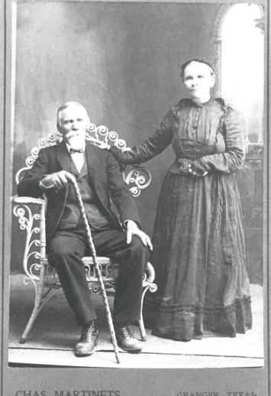
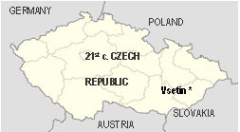
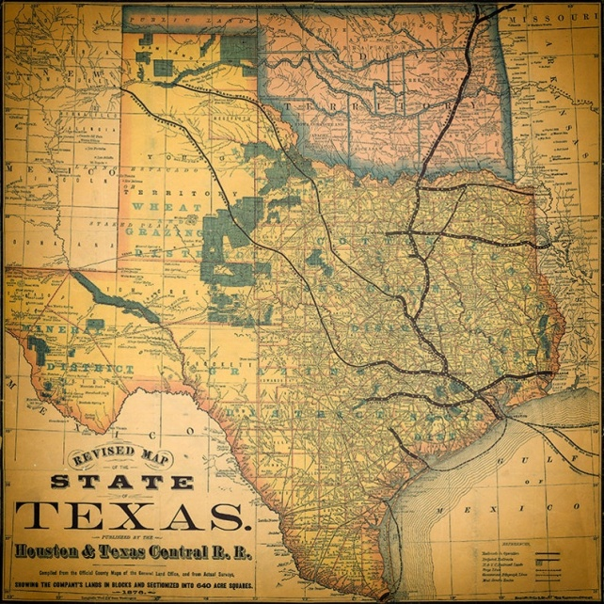
Machu Family Reunion
Beyersville, Texas
September 25, 2022

Slide 2
Machu Family Reunion
2022 Officers
President: Lisa Whisenant
Vice President: Sandra Strmiska
Treasurer: Nancy Machu
Secretary: Christi Johnson
Machu Cemetery Association
2022 Officers
President: Sandra Strmiska Vice President: Johnny Machu
Treasurer: Albin F. Machu
Secretary: Marie Ann Ripple Reporter: Debra Haag

Slide 3
Machu Cemetery Association
2022 Officers
President: Sandra Strmiska Vice President: Johnny Machu
Treasurer: Albin F. Machu
Secretary: Marie Ann Ripple Reporter: Debra Haag
Machu Cemetery Association Officers Meeting
Saturday October 22, 2022
2:00 p.m.
at Machu Cemetery Pavilion
(in case of inclement weather, Sirloin Stockade Private Room)

Slide 4
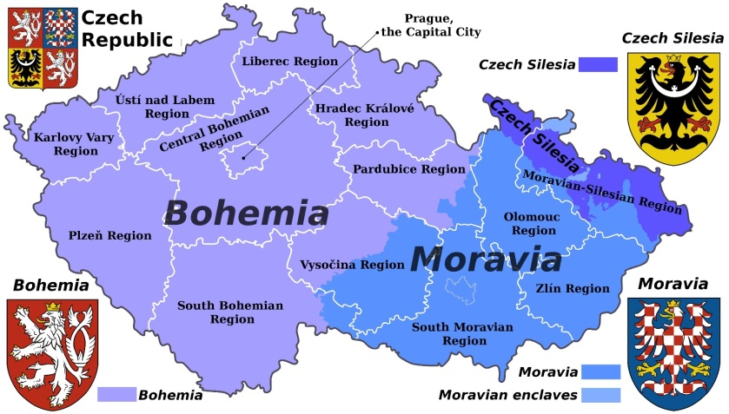
Machu Family
The Machu Family originated in Seninka, a short distance south of Vsetin in the eastern, Moravian region of today’s Czech Republic (or, Czechia).

Slide 5
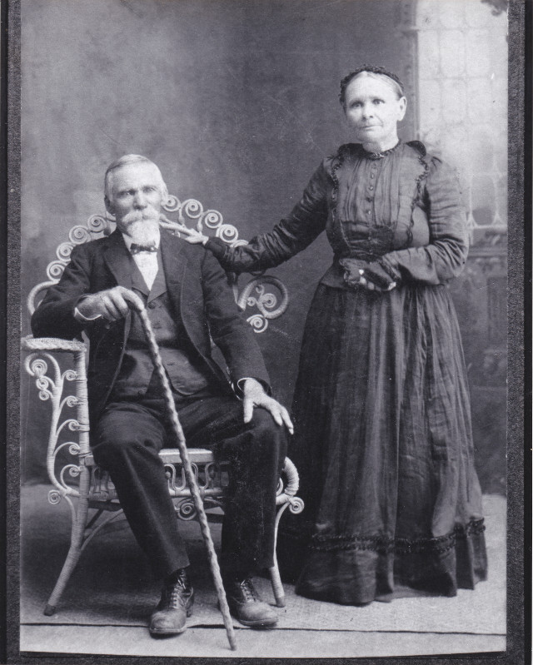
Our Patriarch and Matriarch:
1864: Pavel Machu marries Rozina Trlica.
1870: Pavel applies for permission to emigrate to the USA.
YOUR MACHU ANCESTORS?
April 7, 1870: The family sets sail from the port of Bremen, Germany.
June 2, 1870: The Machu family arrives in Galveston, Texas.
Three children came to U.S. with them:
Anna, who later married Joseph F. Cervenka,
Jan (John) T., who married Veronika Pokorny,
Pavel (Paul) H. who married Rozie Wentrcek.

Slide 6
Jak se máš?
“How are you?"
It's a commonly used greeting phrase for Czechs in the U.S.
Typically the reply is
Dobře!
“Good!”

Slide 7
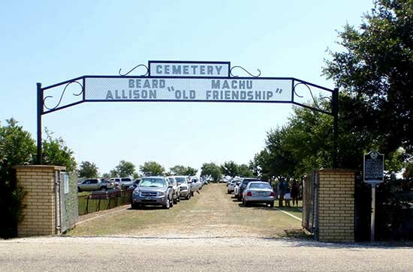
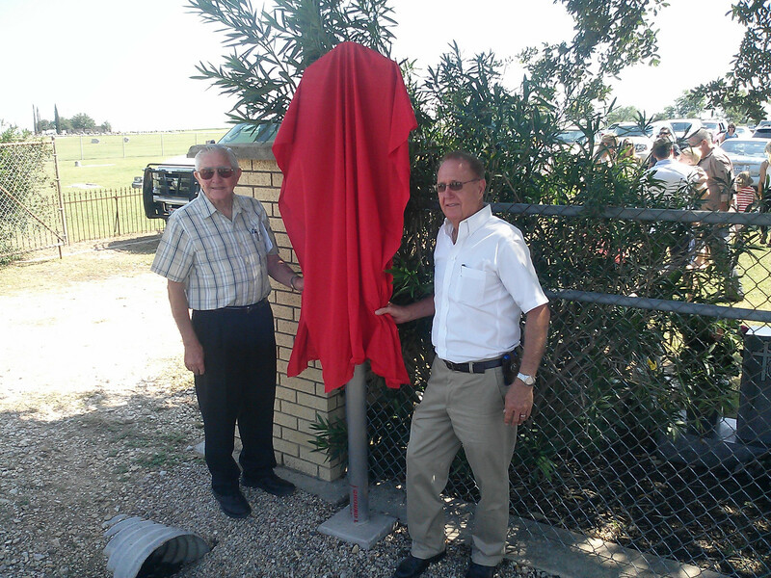
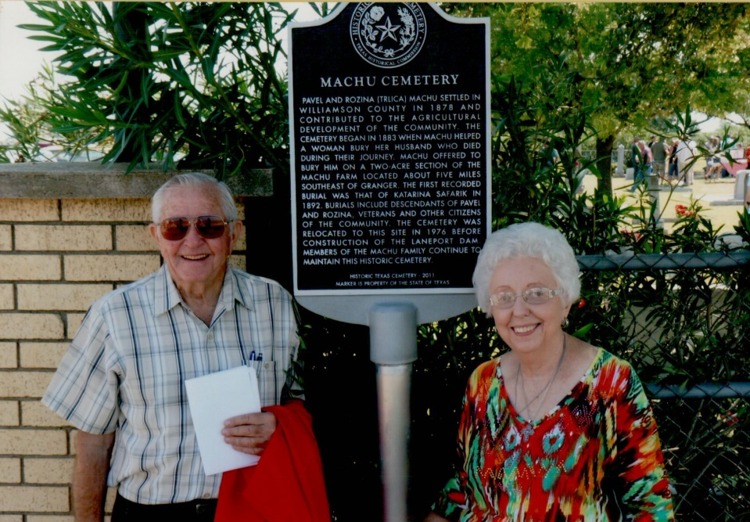
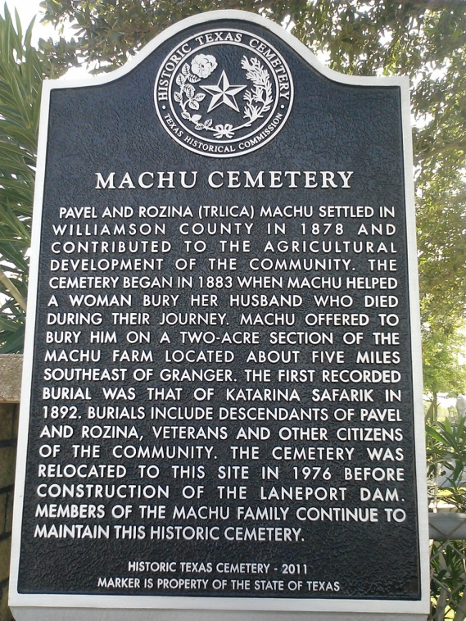
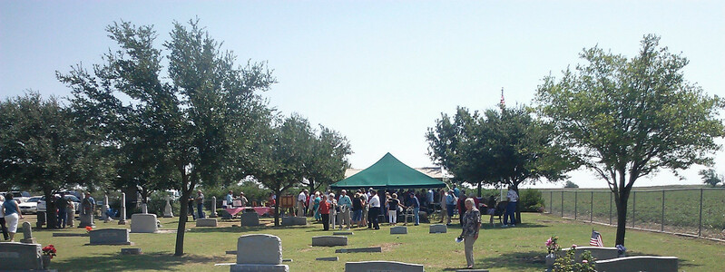
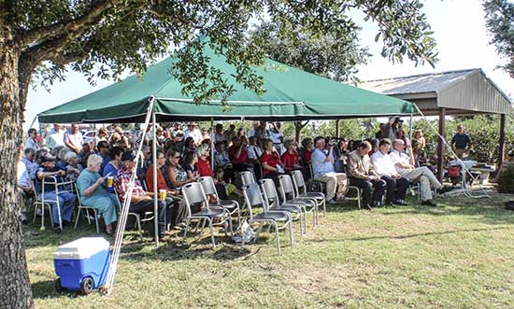
Machu Family
Over 100 attended the Dedication Ceremony for our Cemetery’s Historical Marker on August 17 2013.
Thank you Darwin & Nancy for the research and application work to attain this goal and all who made the special day possible.
Darwin & Albin unveiling Marker

Slide 8
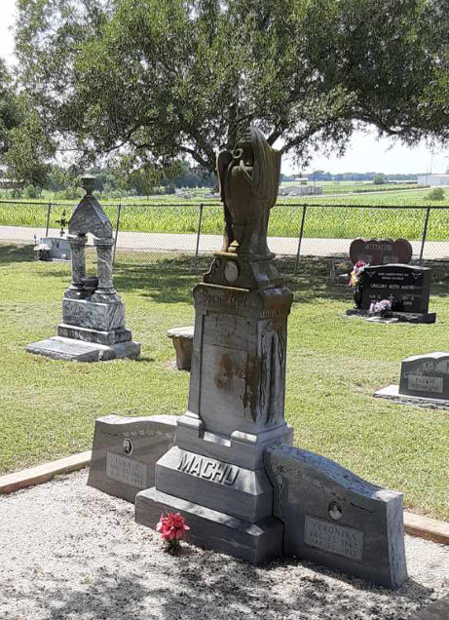
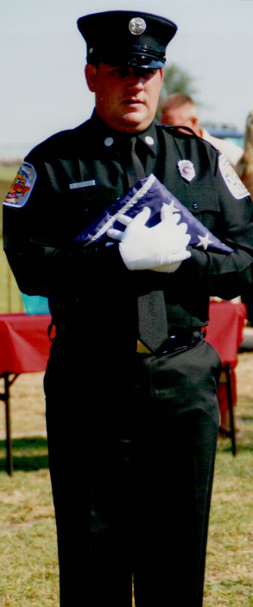
Machu Family
Over 100 attended the Dedication Ceremony for our Cemetery’s Historical Marker on August 17 2013.
Right: The Dedication Ceremony opened with the Presentation of the Colors
by Matt Whisenant

Slide 9
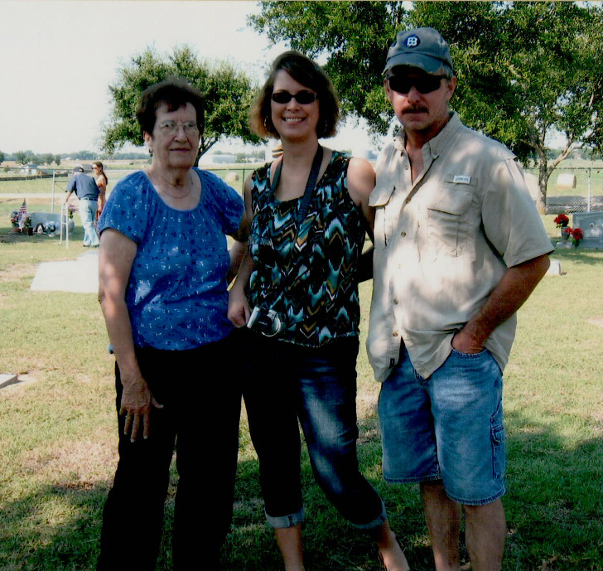
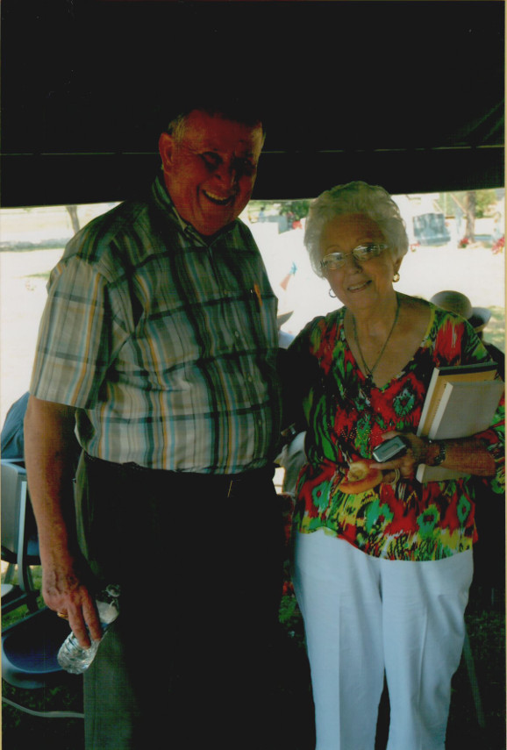
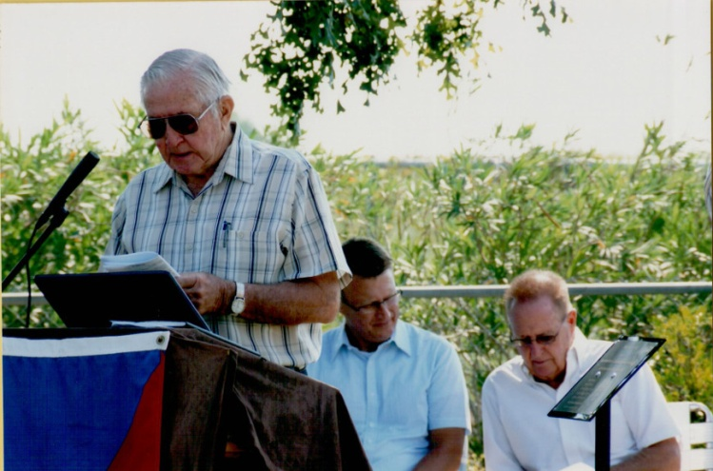
Dedication Ceremony for our Cemetery’s Historical Marker on August 17 2013.
Machu Family
Alice (Machu) Stojanik, Roger & Melody Stojanik Huber;
Henry Holubec with Nancy Machu;
Darwin Machu presenting at ceremony.

Slide 10
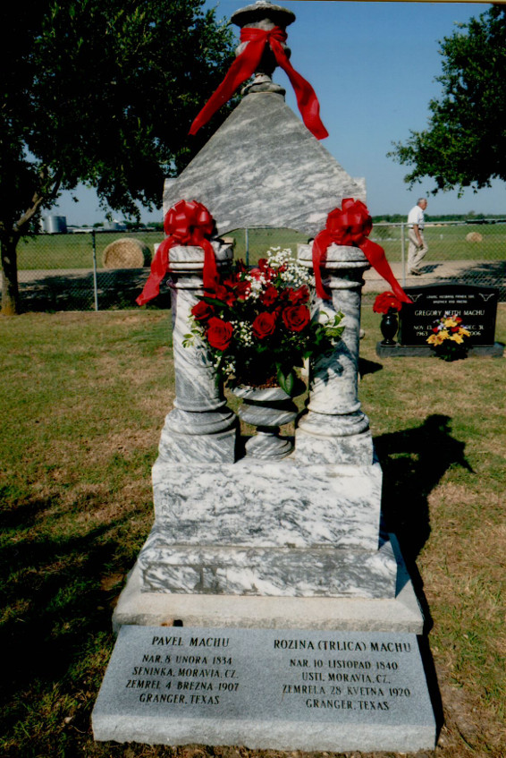
Machu Family Cemetery
Our Family’s Jewel
Pavel & Rozina’s Monument
www.machu-cemetery.org/gallery.php

Slide 11
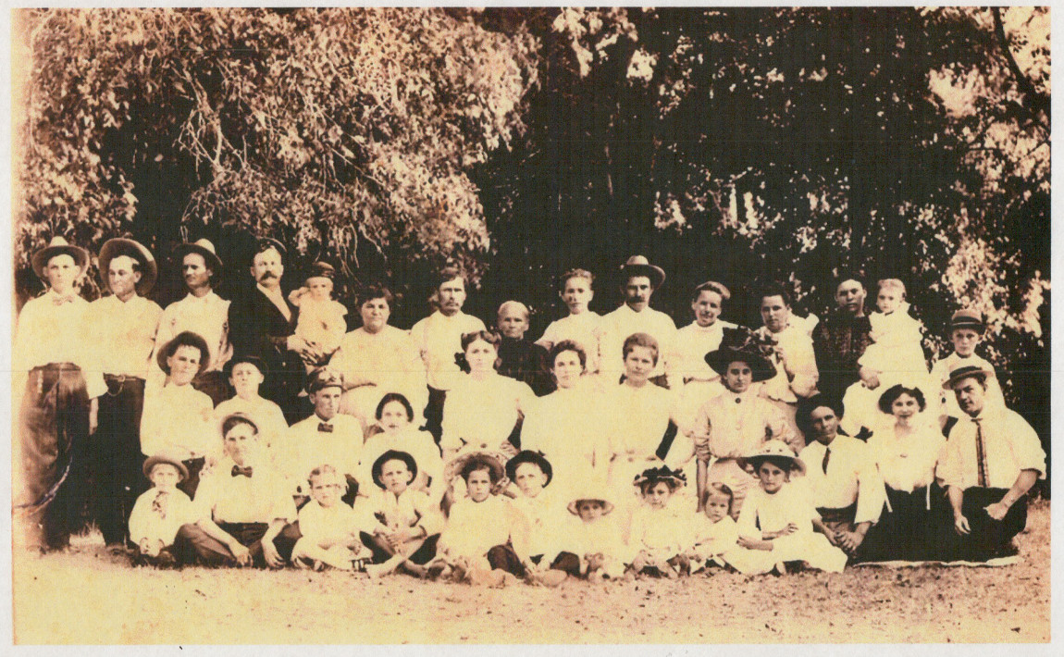
After Pavel died, Rozina (Trlica) Machu sat for this photo with her entire Machu clan
YOUR MACHU ANCESTORS?

Slide 12
Please
Prosim (proseem)
Thank You
Dekuji (dyekuyi)

Slide 13
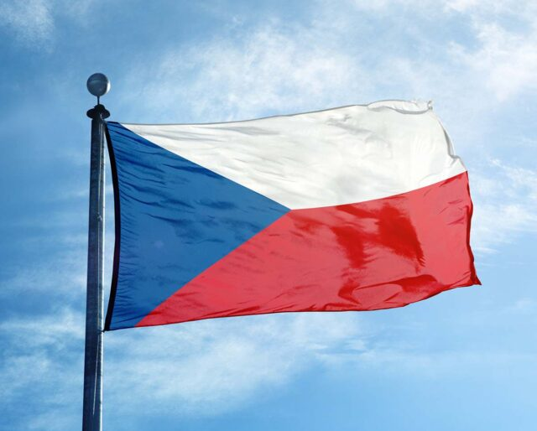
Machu Family
October is Czech Heritage Month, and many Texas Czechs fly the flag of their ancestral home during this month.
Czech Founding Day takes place on October 28 every year, a day of celebration and fun because it observes the founding of the first independent Czechoslovakian state.

Slide 14
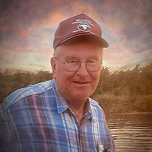
Daniel Darwin Filla, age 83, of Taylor passed away peacefully at home on Friday, June 17, 2022.
Dan was born to Leo and Vlasta (Machu) Filla on February 24, 1939, in Granger, TX.

Slide 15
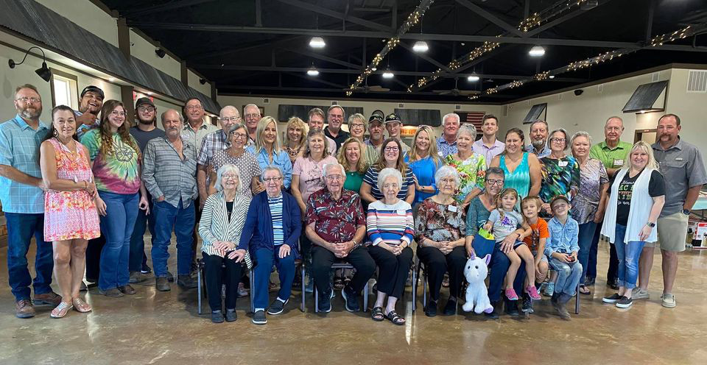
Machu Family Reunion
Beyersville, Texas
2021

Slide 16
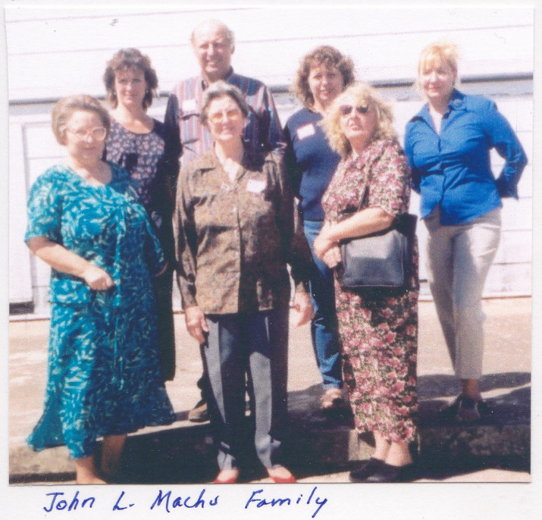
Machu Family Reunion
2003
John L. Machu descendants
20 years ago

Slide 17
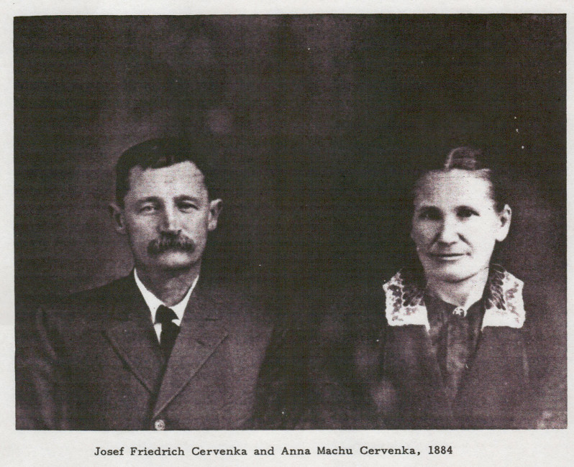
Pavel & Rozina Machu
had 9 children:
Anna, Paul, Rosie, Joe R., Frances, Charles, Mary, Frank Louis, and John T.
YOUR MACHU ANCESTORS?
Josef and Anna Machu Cervenka in 1884

Slide 18
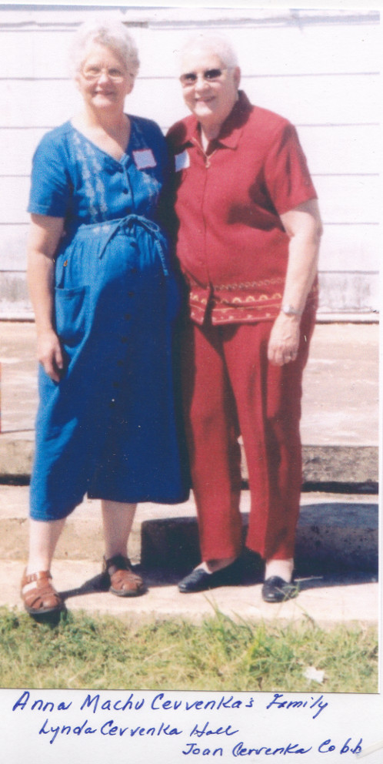
Machu Family Reunion
2003 Anna Machu Cervenka descendants
20 years ago
Lynda Cervenka Hall
Joan Cervenka Cobb

Slide 19
1 – Jedna
2 – dva
3 – tři
4 – čtyři
5 – pět
6 – šest
7 – sedm
8 – osm
9 – devět
10 – deset

Slide 20
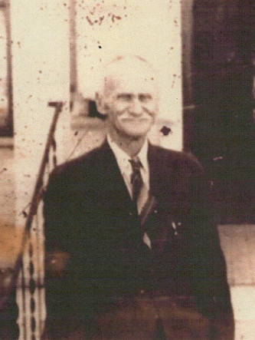
Pavel & Rozina Machu
had 9 children:
Anna, Paul, Rosie, Joe R., Frances, Charles, Mary, Frank Louis, and John T.
YOUR MACHU ANCESTORS?

Slide 21
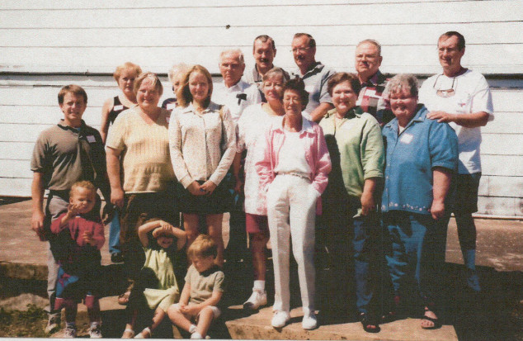
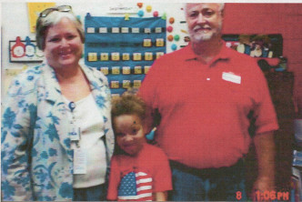
YOUR MACHU ANCESTORS?
Paul H. Machu (left) descendants, including Cindy and Mark Montgomery (right)

Slide 22
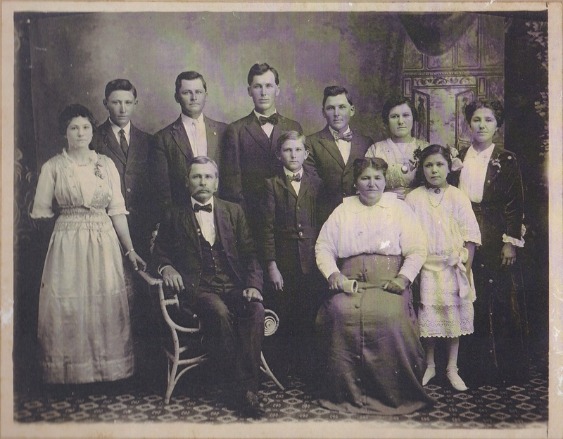
Our Patriarch and Matriarch:
Pavel & Rozina Machu
had 9 children: Anna, Paul, Rosie, Joe R., Frances, Charles, Mary, Frank Louis, and John T.
YOUR MACHU ANCESTORS?
Pictured : John T. Machu
and his wife Veronika (Pokorny) and their 9 children.

Slide 23
Pictured : John T. Machu
and his wife Veronika (Pokorny) have one of the more impressive monuments at the
Machu Family Cemetery.
The couple were active pillars
in the life of their Czech community in Williamson County, while raising their nine
children.
John T. was a leader at the local and state level in the Czech Brethren Church and S.P.J.S.T.
YOUR MACHU ANCESTORS?

Slide 24
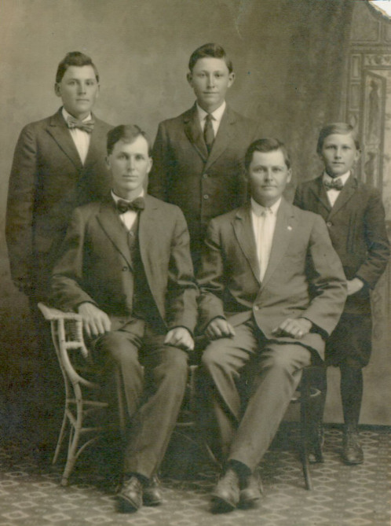
YOUR MACHU ANCESTORS?
The sons of John T. Machu:
Joe, John,
Frank, Anton, Raymond

Slide 25
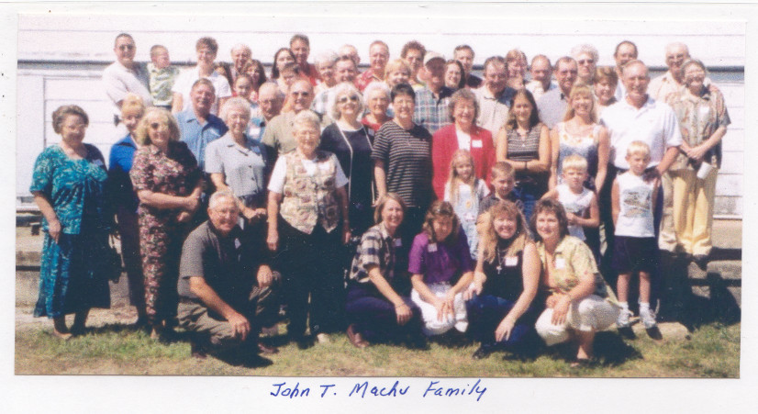
Machu Family Reunion
2003 John T. Machu descendants
20 years ago

Slide 26
Bez práce nejsou koláče.
“Without work, there are no koláčes!”
A meaningful proverb that,
not surprisingly,
reflects the Czech culture’s work ethic!

Slide 27
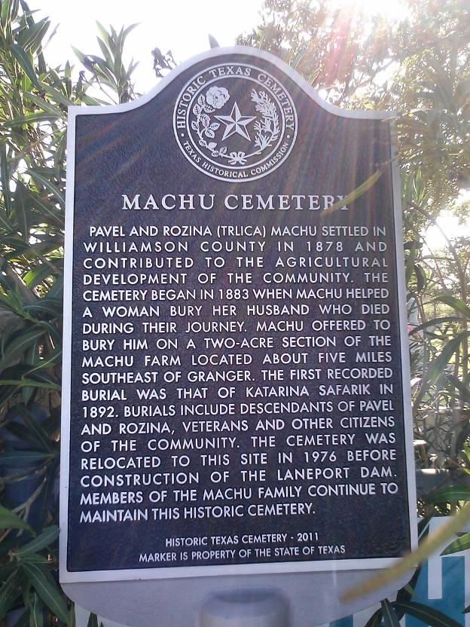
Please consider making a Memorial Donation in the name of a loved one toward the Perpetual Care and Restoration projects of our Cemetery.
Send donations to:
Machu Cemetery Association c/o Albin F. Machu 909 T. H. Johnson Dr. Taylor, TX 76574
machu-cemetery.org

Slide 28
Over 40 Archival Photos
WOULD YOU LIKE A COPY OF THIS PRESENTATION? HERE IS A GREAT RESOURCE FOR INTRODUCING YOUR YOUNGSTERS (and those new In-Laws) TO OUR FAMILY HISTORY & ANCESTORS
View Anytime or Download it at:
Machu-cemetery.org/Gallery.php

Slide 29
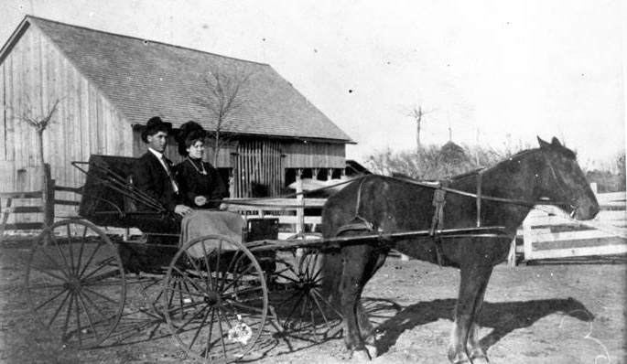
Can you identify this smartly dressed church-going couple?
YOUR MACHU ANCESTORS?
Joe and Albina Machu; circa 1905

Slide 30
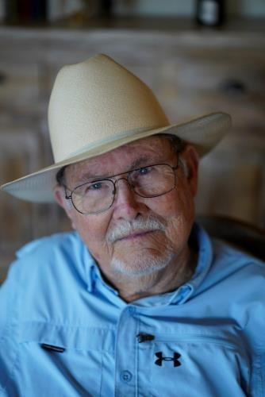
Arthur von Rosenberg of Spring Branch rode into the sunset October 16th, 2020.
Arthur was born to Joseph von Rosenberg and Jennie Lillian Crook von Rosenberg
July 27th, 1936 in Lockhart.
He and wife Frances were very instrumental in the publishing of the last Machu Family Cookbook.

Slide 31
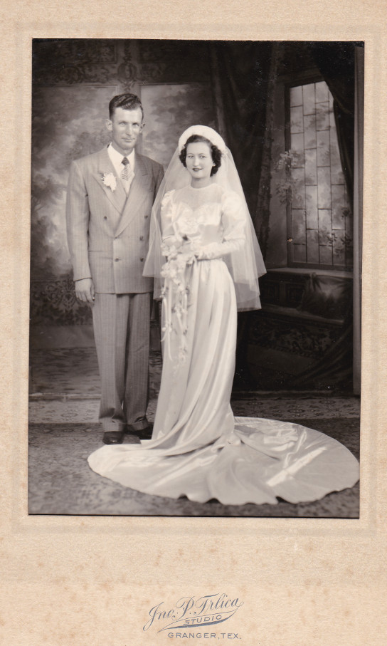
YOUR MACHU ANCESTORS?
Can you identify this couple?
It is

Slide 32
Dobrá rada nad zlato.
“Good advice is better than gold.”
Hněv je špatný rádce.
“Anger is a bad advisor.”

Slide 33
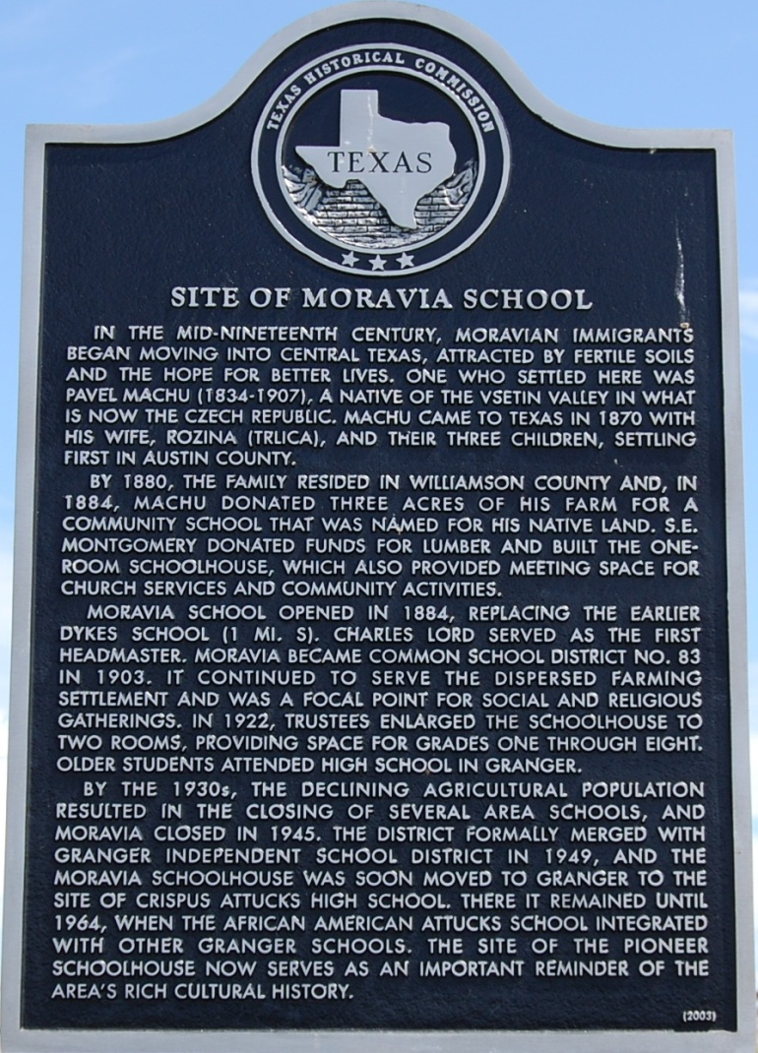
Machu Family
Imagine - an immigrant with no education and limited English, Pavel managed to provide a school in central Texas for the children of his fellow countrymen from Moravia. Pavel Machu committed himself to getting the Moravia School built, aided by other farmers living nearby. He donated a portion of his farm for the school and traveled to surrounding towns on horseback, soliciting funds for construction costs.

Slide 34
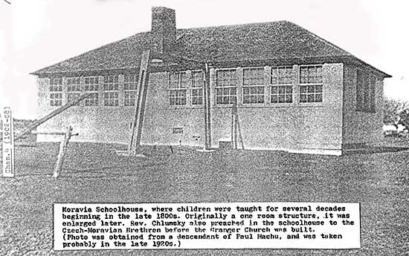
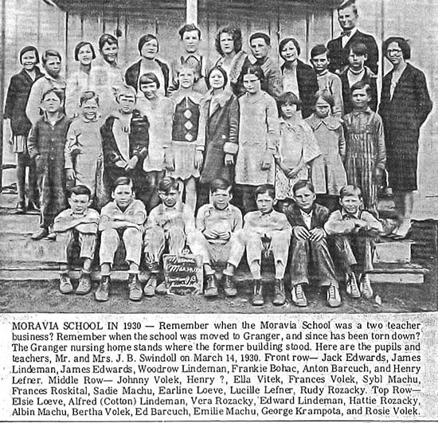
Pavel Machu committed himself to getting the Moravia School built.
Machu Family

Slide 35
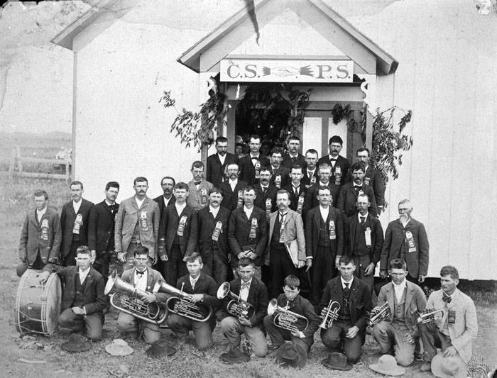
In addition to his efforts to found the Moravian School for his Czech community, Pavel was also instrumental in forming a fraternal insurance agency to aid his Czech neighbors in need.
Machu Family
That early agency was the Cesko-Slovanska Podporujici Spolecnost (CSPS) Lodge in Granger. The CSPS was absorbed by SPJST organization after 1897..

Slide 36
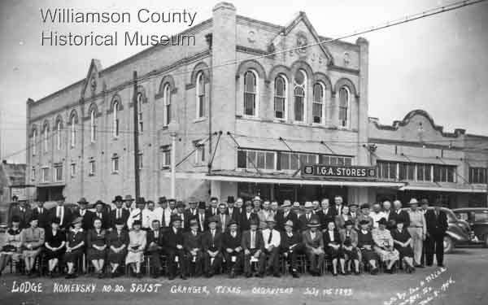
Machu Family
Pavel and Rozina were among the founding members of Granger's Lodge 20 of the Czech fraternal insurance group SPJST. Members posed here in front of the lodge hall, a city property the lodge purchased from Rozina
in 1907.
Photo taken by Pavel and Rozina's nephew John P. Trlica, the well-known Granger photographer.

Slide 37
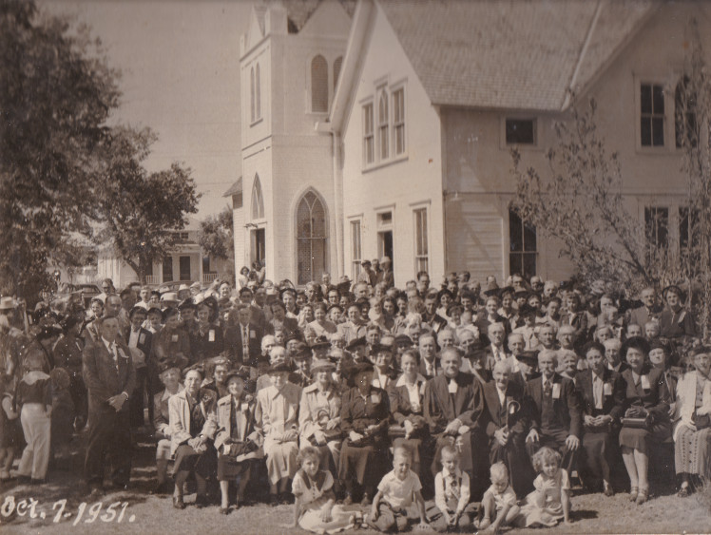
Pavel and Rozina were instrumental in establishing the first Czech Protestant church
in central Texas, the Czech Moravian Brethren Church, a denomination whose origins date
back to the 15th century Hussites of Czech Bohemia. The first church services in the area were held at the Moravia School.
Machu Family
Pavel and Rozina’s children and grandchildren’s rites of passage centered around the Brethren Church.
In this 1951 pic of a State Convention are 25 Machu family members!

Slide 38
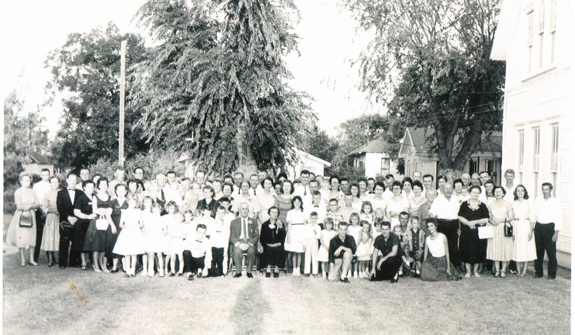
All of Pavel and Rozina’s children and grandchildren’s rites of passage centered around the Brethren Church
Below, their grandson Joe M. Machu and wife Tracy (Zetak) celebrate their 60th anniversary with the Machu clan.
Machu Family

Slide 39
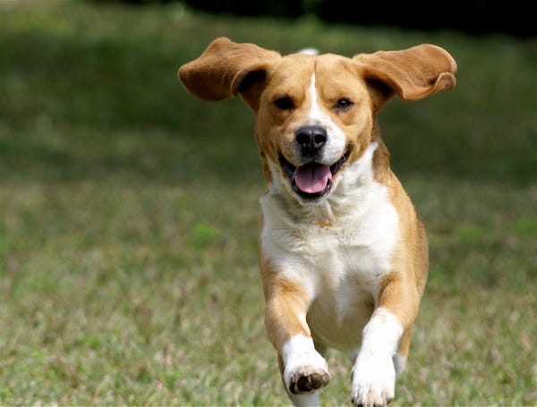
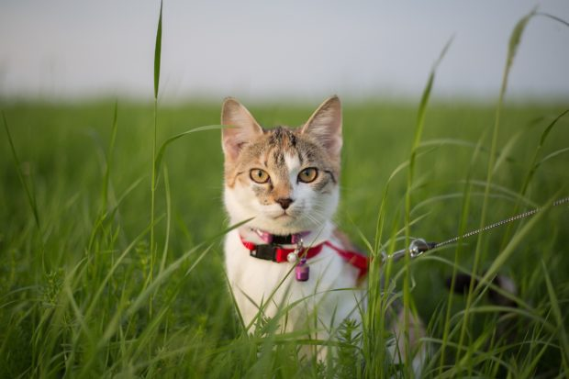
Pes
Kočka

Slide 40
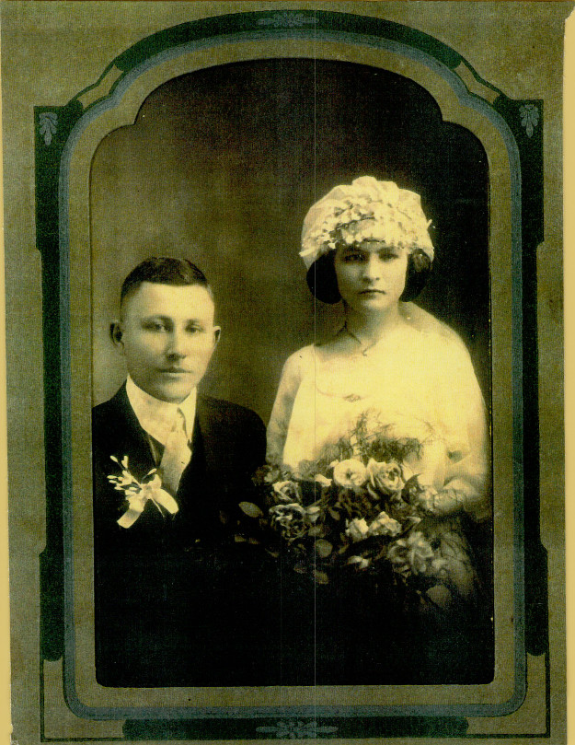
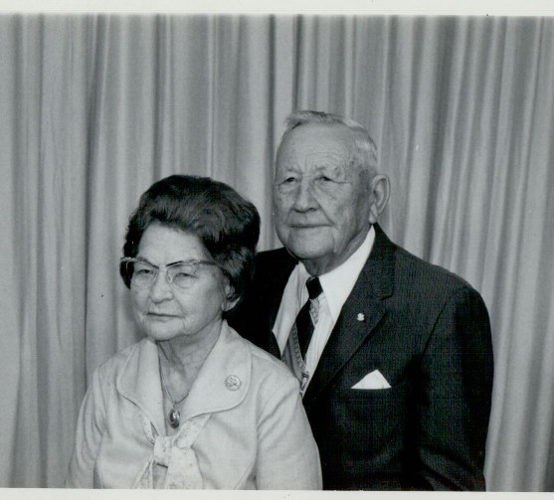
YOUR MACHU ANCESTORS?
Anton & Millie Machu

Slide 41
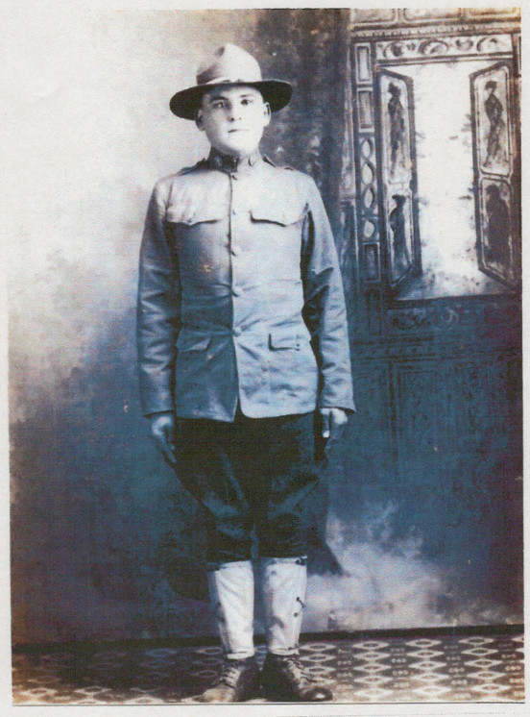
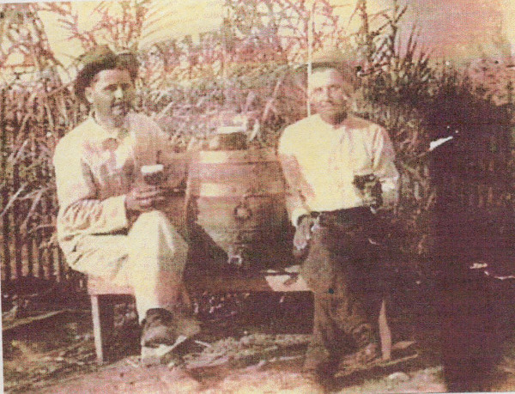
YOUR MACHU ANCESTORS?
World War I Veteran Frank Machu
Left: Frank and John L. Machu

Slide 42
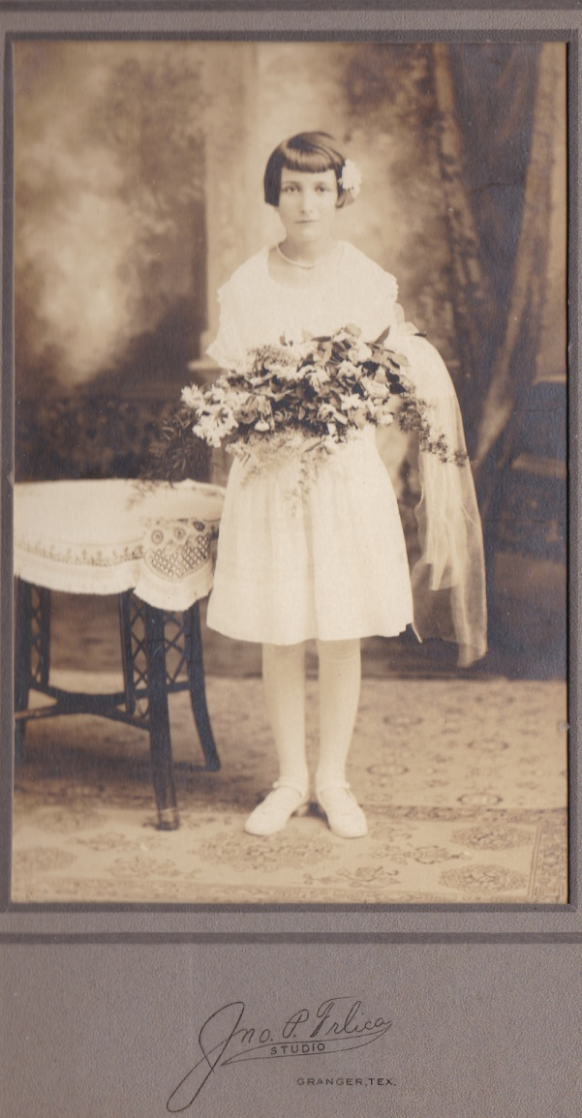
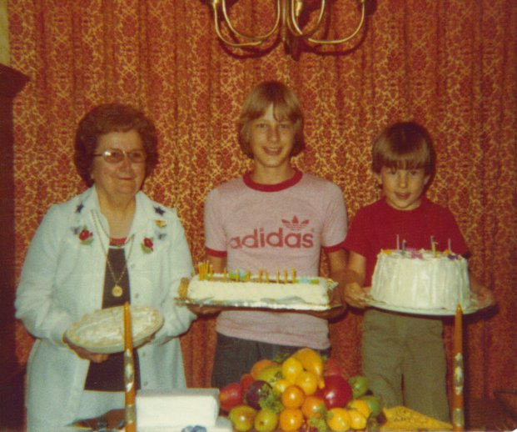
Hattie Machu confirmation photo.
YOUR MACHU ANCESTORS?
Hattie Machu Holubec Kollaja with her grand-nephews Terry and Kelly Loessin. She baked 3 cakes for Terry’s confirmation!

Slide 43
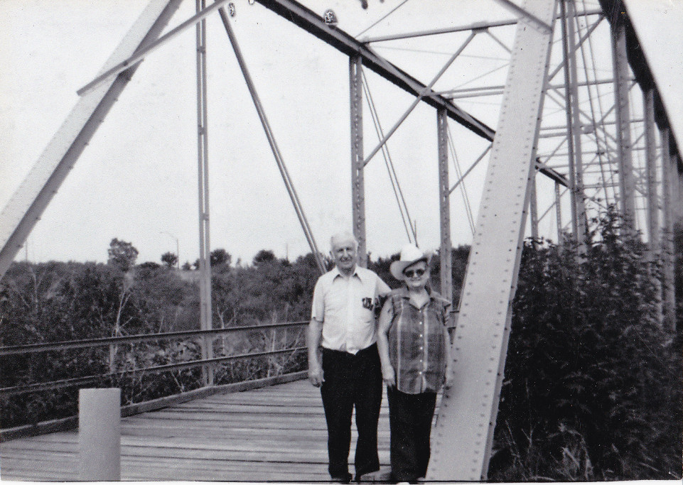
YOUR MACHU ANCESTORS?
Albin E. and Vlasta Machu on the old Hoxie Bridge.
What? You don’t know the ghost stories about this infamous bridge?
You need to talk to one of your elder family members!

Slide 44
YOUR MACHU ANCESTORS?
Four Generations of Machus:
Albin E., Joe M., John T. Albin F. in foreground.

Slide 45
YOUR MACHU ANCESTORS?
Four Generations:
Joe M. Machu, Albin E. Machu, Albin F. Machu, Terry Loessin

Slide 46
Family = Rodina
Mother = Matka Father = Otec
Mom = Maminka Dad = Táto
Grandma = Babička Grandpa = Dědeček
Children = Děti
Son = Syn boy = chlapec Daughter = Dcera girl = dívka

Slide 47
Our Patriarch and Matriarch:
Pavel & Rozina Machu
had 9 children: Anna, Paul, Rosie, Joe R., Frances, Charles, Mary, Frank Louis, and John T.
YOUR MACHU ANCESTORS?
Pictured : Charles Machu
and his wife Frances (Mickolas).

Slide 48
Pavel & Rozina Machu
had 9 children: Anna, Paul, Rosie, Joe R., Frances, Charles, Mary, Frank Louis, and John T.
YOUR MACHU ANCESTORS?
Pictured : Joe R. Machu
and his wife Marie (Wentrcek).

Slide 49
Pavel & Rozina Machu
had 9 children: Anna, Paul, Rosie, Joe R., Frances, Charles, Mary, Frank Louis, and John T.
YOUR MACHU ANCESTORS?
Frances Machu with Frank Shiller and
adopted son Frank
in the Machu store
East Davilla St.
in Granger, TX

Slide 50
Butchers in street outside the adjacent meat market beside the J. R. Machu Grocery Store, Granger, Texas, ca. 1903.

Slide 51
Hi! I am ______
Ahoj! Já jsem ______
What is your name?
Jak se jmenuješ?
Glad to meet you! Rád tě poznávám!

Slide 52
Pavel & Rozina Machu
had 9 children: Anna, Paul, Rosie, Joe R., Frances, Charles, Mary, Frank Louis, and John T.
YOUR MACHU ANCESTORS?
Rosie Machu married Henry Rozacky

Slide 53
YOUR MACHU ANCESTORS?
John and Frances Machu

Slide 54
YOUR MACHU ANCESTORS?
Alice Machu marries Edwin Stojanik

Slide 55
Good day (How do you do) Dobry den (dobree den)
Good morning
Dobre rano (dobreh rahno)
Good night Dobrou noc (dobrow nots)
Prague at morning
Prague at night

Slide 56
Machu Family Reunion
2022 Officers
President: Lisa Whisenant
Vice President: Sandra Strmiska
Treasurer: Nancy Machu
Secretary: Christi Johnson
Machu Cemetery Association
2022 Officers
President: Sandra Strmiska Vice President: Johnny Machu
Treasurer: Albin F. Machu
Secretary: Marie Ann Ripple Reporter: Debra Haag

Slide 57
Machu Cemetery Association
2022 Officers
President: Sandra Strmiska Vice President: Johnny Machu
Treasurer: Albin F. Machu
Secretary: Marie Ann Ripple Reporter: Debra Haag
Machu Cemetery Association Officers Meeting
Saturday October 22, 2022
2:00 p.m.
at Machu Cemetery Pavilion
(in case of inclement weather, Sirloin Stockade Private Room)

Slide 58
Machu Family Cemetery
Our Family’s Jewel
What a beautiful setting.
The Pavilion provides funeral attendees shade on hot sunny days and shelter from rain.
And on our family workdays,
we break bread together here and share in a bit of svacina (breaktime snacks!)

Slide 59
Machu Family Cemetery
Our Family’s Jewel
Meditation Corner.
The Cemetery’s Cross, a donation from the Albin E. Machu family, serves to remind visitors to our cemetery of our family’s Christian heritage and, as well, assures all who mourn here of the promise that this religious symbol holds for Christians
of the forgiveness of sins and life eternal.

Slide 60
Machu Family Cemetery
Albin E. Machu was instrumental in assisting the United States Corps of Engineers with the relocation of the cemetery in 1977 and would be honored in 1981 with a Take Pride in America plaque presented by the U.S. Corps of Engineers.
Our Family’s Jewel
And not just for his work with the cemetery but also for his work "providing sight reports of protected wildlife species and his volunteer efforts that helped establish the multiple game preserves enjoyed around the lake area today."

Slide 61
The Machu Family Cemetery contains 900 burial plots and presently has over 200 identified graves with tombstones and 60 graves of unknown persons on the 3-acre site it was relocated to in 1976.
Machu Family
Our Family’s Jewel
Rededication ceremonies were held on May 29, 1977
Have you and your loved ones reserved your own plots?
Machu-cemetery.org

Slide 62
Rain!
Déšť!
We need rain!
Potřebujeme déšť!
Rainy Day on Charles Bridge; Prague, CZ

Slide 63
Machu Family Cemetery
THERE IS ALWAYS WORK TO BE DONE
Our Work Days posted 2-weeks prior at
machu-cemetery.org/eventscalendar
Our Family’s Jewel
Rhonda Machu Roten doing great job cleaning the headstones!
Victor Joe Holubec and Albin F. Machu go after it
on potty detail!

Slide 64
Machu Family Cemetery
Our Family’s Jewel
Thank you Albin F. Machu for your years of dedicated volunteer service to our family’s historic cemetery. Your commitment to watering saplings that grew to be beautiful trees, tree trimming, coordinating with City staff and Funeral homes, orchestrating burials, ensuring the potty and lawn cared for, installation of infrastructure, and this list goes on… Your years of service are an inspiration to us all.
Notes:
our

Slide 65
Over 40 Archival Photos
WOULD YOU LIKE A COPY OF THIS PRESENTATION? HERE IS A GREAT RESOURCE FOR INTRODUCING YOUR YOUNGSTERS (and those new In-Laws) TO OUR FAMILY HISTORY & ANCESTORS
View Anytime or Download it at:
Machu-cemetery.org/Gallery.php

Slide 66
Machu Family Cemetery
THERE IS ALWAYS WORK TO BE DONE
Our Work Days posted 2-weeks prior at
machu-cemetery.org/eventscalendar
Our Family’s Jewel
On the Riding Mowers:
Angie Machu Malicoat T. J. Mikulec Leslie Loessin

Slide 67
Machu Family Cemetery
THERE IS ALWAYS WORK TO BE DONE
Our Work Days posted 2-weeks prior at
machu-cemetery.org/eventscalendar
Our Family’s Jewel
Angie Machu Malicoat regularly volunteers on Cemetery Workdays, here with brother Marvin Machu and nephew Terry Loessin

Slide 68
Machu Family Cemetery
THERE IS ALWAYS WORK TO BE DONE
Our Work Days posted 2-weeks prior at
machu-cemetery.org/eventscalendar
Our Family’s Jewel
Left: Machu Cemetery Association President Sandra Machu Strmiska giving it her all!
Right: Sharon Machu Mikulec wielding a weedeater and making it all pretty!

Slide 69
God
Bůh
God bless you
Bůh ti žehnej

Slide 70
God
Bůh
God bless you
Bůh ti žehnej
THE LORD’S PRAYER: Our Father, who art in heaven, hallowed be thy name; thy kingdom come, thy will be done, on earth as it is in heaven. Give us this day, our daily bread, and forgive us our trespasses as we forgive those who trespass against us. And lead us not into temptation, but deliver us from evil.
Amen.
Otče náš, jenž jsi v nebesích, posvéť se jméno tvé; prijd' království tvé, bud' vůle tvá, jako v nebi, tak i na zemi. Chléb náš vezdejší dej nám dnes, a otpusť nám naše viny, jakož i my odpousťíme naším vinníkům. A ne uvod' nás v pokušení, ale zbav nás od zlého.
Amen.

Slide 71
Pavel & Rozina’s grandson Joe M. Machu (son of John T.) married Tracy Zetak in a huge double wedding with John L. Machu and Frances Kopecky.
Left: Joe and Tracy Machu with children Vlasta, Hattie, and Albin E. on knee.
Right: Expanded family with daughters Mildred and Alice added, and grandchildren.
YOUR MACHU ANCESTORS?

Slide 72
YOUR MACHU ANCESTORS?
Above: Albin E. Machu, Hattie Machu Holubec Kollaja, Sybil Machu Stojanik, Mildred Machu Townsend
Left: Albin E., Hattie, Sybil and Vlasta Machu

Slide 73
Edward and Mildred Machu Townsend wedding Attendants: Edwin and Alice Machu Stojanik
YOUR MACHU ANCESTORS?

Slide 74
Willie and Sybil Machu Stojanik wedding
Below left: Sybil Machu, age 2, in 1918.
YOUR MACHU ANCESTORS?

Slide 75
Please consider making a Memorial Donation in the name of a loved one toward the Perpetual Care and Restoration projects of our Cemetery.
Send donations to:
Machu Cemetery Association c/o Albin F. Machu 909 T. H. Johnson Dr. Taylor, TX 76574
machu-cemetery.org

Slide 76
Over 40 Archival Photos
WOULD YOU LIKE A COPY OF THIS PRESENTATION? HERE IS A GREAT RESOURCE FOR INTRODUCING YOUR YOUNGSTERS (and those new In-Laws) TO OUR FAMILY HISTORY & ANCESTORS
View Anytime or Download it at:
Machu-cemetery.org/Gallery.php

